Slide 1
Adobe Experience Cloud
Adobe Experience Manager Architect Workshop
Notes:
Note to CDs: Use this as the cover slide for all the solutions. Per the latest branding, there are no solution-specific slides or logos.

Slide 2
Legal and Confidentiality Information
© 2021 Adobe, Inc. All rights reserved.
Every effort was made to ensure that the information in this document was complete and accurate at the time of printing. However, information is subject to change and Adobe cannot assume responsibility for any errors or omissions. Changes or corrections to the information contained in this document may be incorporated in future issues.
This copyrighted guide along with other materials for this course may not be recorded, reproduced, duplicated, reverse engineered or adapted.
Training is intended only for those individuals who have registered and paid for it; training access URLs, user names and passwords, or access of any kind may not be shared.
This document and other materials for this course are Adobe confidential and proprietary information which must be retained in confidence by the recipient.

Slide 3
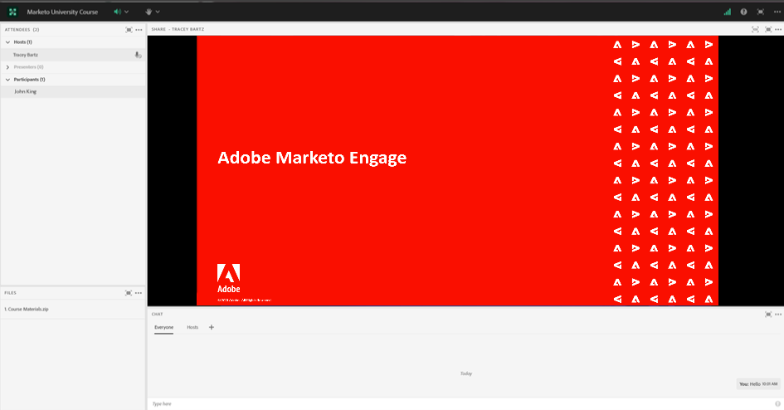
Adobe Connect Features
Raise your hand to confirm with instructor
Download the course materials
Start a private chat
Chat with everyone
You will be on mute.
Notes:
Before we continue, there are a few tips about using Adobe Connect that I’d like to go over.
<click> As you’ve already seen when we checked the audio, you can click the hand icon to confirm that you’ve completed a task or to answer a question I pose.
<click> You have course materials to download as take-aways. If you haven’t downloaded the slide guide and exercises, you can do that now. I’ll also remind you at the end of the course.
<click> During the training, you will automatically be on Mute. This will limit any background noise.
<click> To communicate, you’ll use the chat box for your questions or comments. You can send your chat to the entire group or, if you have a private question just for me, you can start a private chat.
Any questions on using the Adobe Connect platform?

Slide 4
Introducing Your Adobe Digital Learning Services Instructor
Instructor Name Job Title, Adobe Digital Learning Services
Interesting fact
Your experience with Adobe Marketing Cloud
Something awesome about you
Fun Photo of You Here
Notes:
Now, allow me to introduce myself. <Include instructor information.>

Slide 5
Student Introductions
What is your name?
What is your role?
How will you be using Experience Manager?
What version of Experience Manager are you using?
On prem? Managed Services? Cloud Service?
What is your experience with Experience Manager, if any?

Slide 6
Notes:
Note to Instructors: Please delete the slide for ILTs. This slide is applicable for only vILTs.

Slide 7
Course Agenda
Day 1
Module 1: Architecture
Module 2: Content and Code Migration
Module 3: Headless Delivery and SPAs
Day 2
Module 4: Adobe Experience Manager as a Cloud Service
Module 5: Adobe Experience Manager Projects and Code Deployment
Module 6: Security
Day 3
Module 7: JCR Model, Queries and Indexes
Module 8: Performance
Module 9: Solution Design
Notes:
Let’s review our agenda.
Today, on Day 1, we will start with Course Setup, where we will begin by taking a tour of the platform and learning about the database.
We will then dive in to Lesson 1 to learn about program basics and how to deploy a monthly newsletter.
After our 1-hour lunch break, we will begin Lesson 2, where you will learn about dynamic lists and email A/B testing.
Then, we will begin Lesson 3, which will review creating segmentations and dynamic emails.
We will end the day by working on a lab exercises to ensure that you’ve retained everything you learned thus far.

Slide 8
Adobe Experience Manager Architecture

Slide 9

Experience Manager 6+ On Premises Runtime Environment
Retrieve
Web Server
Dispatcher
Author
Publish
Invalidate
Disk Cache
Content
JCR
Publish
Replication Agent
Queue
Load Balancer
Retrieve
Web Server
JCR
Dispatcher
Publish
Invalidate
Disk Cache
JCR

Slide 10
Experience Manager 6+ Deployed in AMS: Runtime Architecture
Adobe Managed Services
Apache Web server/dispatcher
Apache Web server/dispatcher
CI/CD Service
AEM Publish
AEM Publish
AEM TarMK Author
Amazon Web Services or Azure

Slide 11
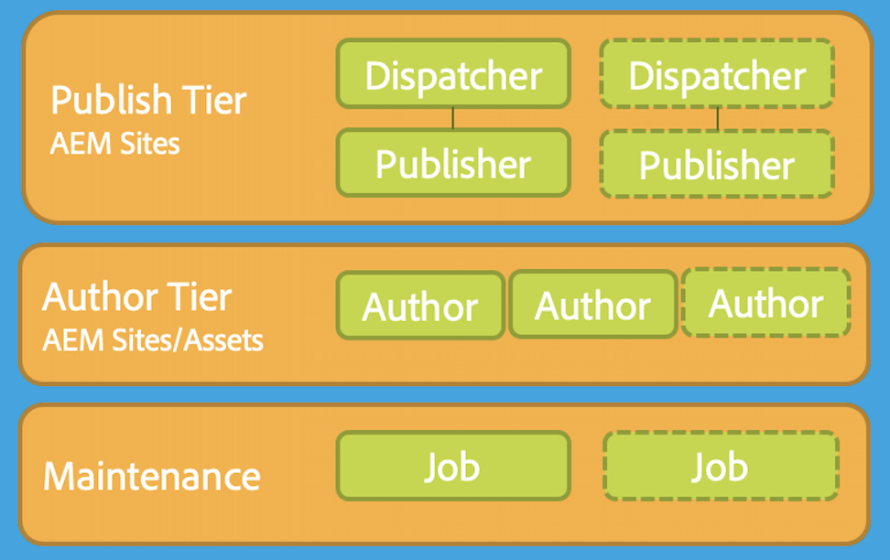

Adobe Experience Manager Cloud Service: Runtime Architecture
Per Environment
CDN Service
Shared Service
Containers
Replication Service
Content Repository Service
CI/CD Service
Identity Management Service
Assets Compute Service
Container Orchestration Service
Notes:
Author Tier: made of two or more nodes within a single author cluster. It scales automatically, dependent on the authoring activity.
Publish Tier: comprised of two or more nodes within a single publish farm: they can operate independently from each other. Each node consists of an AEM publisher and a web server equipped with the AEM Dispatcher module. It scales automatically with site traffic needs.
Content Repository: Both the author tier and publish tier read and persist content from/to a Content Repository Service.
Publish tier only reads content from the persistence layer.
Author tier reads and writes content from and to the persistence layer.
Blobs storage is shared across the publish and the author tier; files are not moved .
Replication Service: Approved content is pushed to the publish tier persistence layer via the Replication Service, a middleware pipeline. This pipeline receives the new content, with the individual publish service nodes subscribing to the content pushed to the pipeline.
Authentication: IMS
Access: via a load balancer. This is always up-to-date with the active nodes in each of the tiers. For the publish tier, a Continuous Delivery Network (CDN) Service is also available as the first entry point.
AEM Assets: includes only an authoring environment. Assets integration and processing use a dedicated Assets Compute Service.

Slide 12

Experience Manager Technical Architecture

Slide 13
Adobe Experience Manager Platform
Open-source elements:
OSGi Application Runtime – Apache Felix
Java Content Repository (JCR) - Apache Jackrabbit Oak / CRX
Web Application Framework – Apache Sling
Proprietary components:
Granite / Coral UI framework
Workflow Engine
Asset and Asset Metadata (XMP) Support
Translation, Localization, and Internationalization
Experience Platform support
AEM Application Layer
Apache Sling
Web Application Framework
Apache Jackrabbit Oak
JCR Repository / Storage Layer
Apache Felix
OSGi Java Container
Notes:
Technical Architecture has not changed.

Slide 14
Open Services Gateway interface (OSGi)

Slide 15
The OSGi Framework
OSGi:
Can replace code pieces without taking the server down
Enables building applications as a set of redo-able and strongly encapsulated services
OSGi bundles:
They are JAR files containing extra metadata
They run inside an OSGi container that manages relations among bundles
More than one version can be run in the container at the same time
Version dependencies are resolved by the container
Notes:
To learn more about OSGi, refer to the following links:
http://www.osgi.org
http://en.wikipedia.org/wiki/OSGi
To learn more about Apache Felix, refer to the following link:
http://felix.apache.org

Slide 16
Open Services Gateway Initiative (OSGi)
Modular Application Runtime
Features:
Semantic Versioning
Enforced Module Boundaries
Module Lifecycle Management
Inter-Module Communication (Services)
Benefits:
Hot Swappable Code
Clean, Versioned APIs
Service Replacement
Service Registry
Application Code
(Bundles)
Life Cycle Management
Module Management
Execution Environment (Java VM)
Operating System

Slide 17

OSGi
OSGi is a fundamental element in the technology stack of Experience Manager .
Components
Small, reusable, and collaborative components are used
Bundles
Components are composed into bundles
Application
Bundles are composed into an application
17
Notes:
OSGi, a fundamental element in the technology stack of AEM, supports modular deployment of bundles. You can stop, install, and start these bundles individually. The interdependencies are handled automatically. Each OSGi component is contained in one of the deployed bundles. This deployment strategy helps manage applications easily.
OSGi Configurations are system parameters and settings contained in bundles that you can manage and configure.

Slide 18
Java Content Repository

Slide 19
Defining the Java Content Repository (JCR)
JCR is a database that looks like a file system.
Supports unstructured content, and enables versioning and observation.
Provides services such as full-text search, indexing, access control, and event monitoring.
JSR-283 key principles:
Common programmatic interface to content repositories
API not tied directly to the underlying architecture, data source, or protocol
Content organization in a repository model - Hierarchical modeling
Granite repository is based on Apache Jackrabbit Oak, an implementation of JSR 283
Notes:
For more information on JCR, you can refer to the link: www.day.com/specs/jcr/2.0/2_Introduction.html

Slide 20
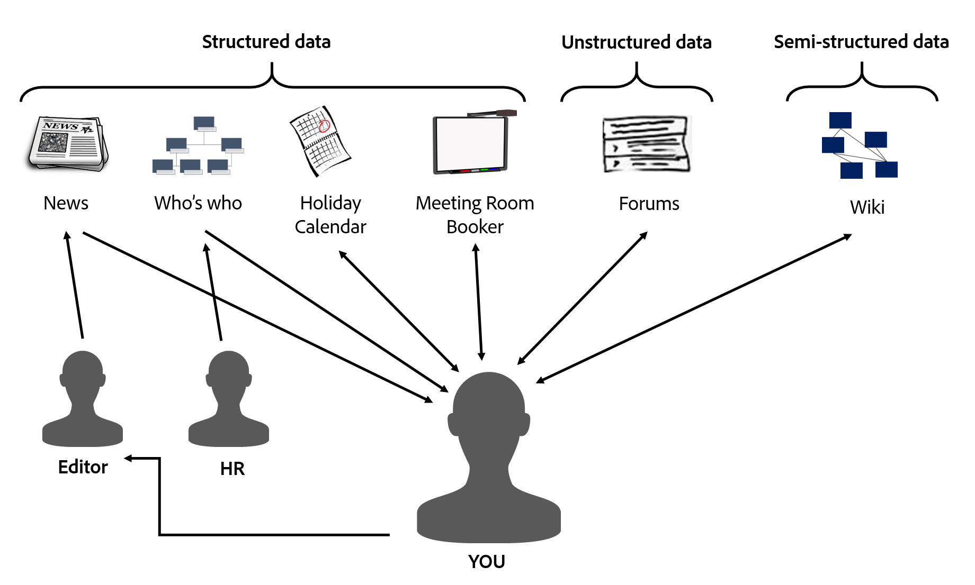
JCR Advantages
JCR provides a generic application data store for structured and unstructured content.
Looks like a file system… Acts like a database… Best of both worlds
Notes:
JCR provides a generic application data store for structured and unstructured content. While file systems provide excellent storage for unstructured, hierarchical content, and databases provide storage for structured data, JCR provides the best of both data storage architectures.
It supports namespaces. Namespaces prevent naming collisions among items and node types that come from different sources and application domains. JCR namespaces are defined with a prefix, delimited by a single colon (:); for example, jcr:title.

Slide 21
Content Repository
Transactions
Query
Structure
Integrity
Binaries
Hierarchy
Locking
Access Control
RDBMS Features
File System Features
Standardized
API
Multi-Value Properties
Unstructured
Ordering
Full Text
Versioning
Observation
Other Good Stuff
Looks like a file system… Acts like a database… Best of both worlds
Notes:
RDBMS = Relational Database Management System
We will cover more JCR in Module 4 – CRX Deep Dive

Slide 22
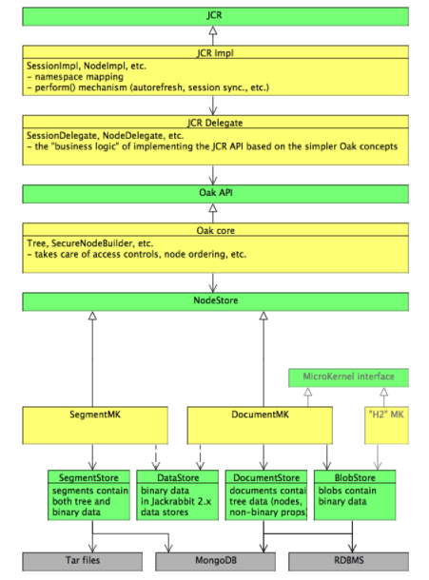
Oak Architecture
Alternate implementation of JSR-283
Core of the Granite repository
Primary goals of Jackrabbit Oak:
Scalability
Big repositories
Distributed repository with many cluster nodes
Improved write throughput, with parallel writes
Support for more Access Control Lists (ACLs)

Slide 23
Understanding the Repository Structure

Slide 24
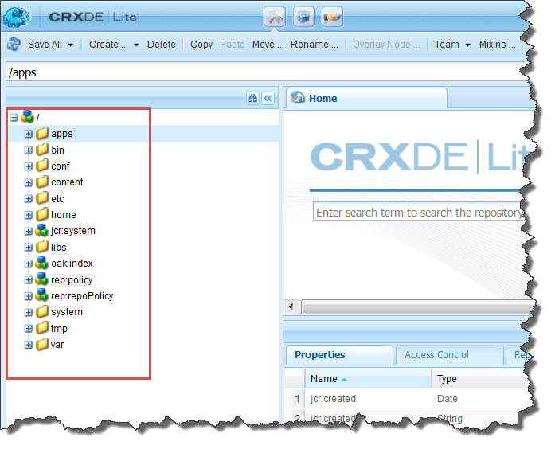
Understanding the Repository Structure
/apps
/libs
/conf
/content
/etc
/oak:index
/home
/tmp
/var
Notes:
/apps – all custom templates, components, and any other definitions related to your site is stored here. When you inherit foundation components, it is done from the libs folder. Always copy the components from libs to apps, and then modify it in apps. By doing this, no code will be lost when an upgrade is done to Adobe Experience Manager. You just need to make the updates to the apps folder. NOTE: Best practice is to use a feature known as Sling Resource Merger, and just duplicate the required /libs folder structure (empty folders) under /apps. Make modifications to the node or property, wherever the changes are required.
/libs –All libraries, and definitions that belong to the code of Adobe Experience Manager are stored here. It includes out-of-the-box components, templates, and other features such as search or replication. It is also referred to as the foundation components. Avoid making any modifications to any of the components in libs.
/content – all content of your website is stored in this folder.
/conf – holds all the application configuration definitions. For example, it is used to store the editable templates, content policies, workflow definitions, cloud configurations.
/etc – contains all resources related to utilities and tools
/home – contains all information related to users and groups.
/tmp – This is a temporary working area
/var – This folder contains files that change and are updated by the system, such as audit logs, statistics, and event handling.
/oak:index – This node contains Jackrabbit Oak index definitions. Each node specifies the details of one index. Standard indexes for the Adobe Experience Manager application are visible and additional custom indexes can be created.

Slide 25
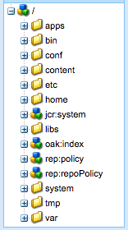
Separation of Application Content and Code/Configuration
Experience Manager 6.5+ recommends separation of content
Cloud Service architecture mandates a complete separation between
Application content
Application code and configuration
Customer application content
Customer application code
Customer application content
AEM UI and other appliation code
Notes:
This and and the following slides talk about the AEMaaCS requirements. At this point you have not yet introduced AEMaaCS, so tell them to be patient to get more information later. The new restrictions are only enforcing what has been best practice for awhile.
AEMaaCS enforces best practices, unlike prior versions of AEM.
It it’s not application content, code, or configuration, then it belongs to AEM.
Application code and configuration are immutable. Application content is mutable.

Slide 26
Separation of Application Content and Code/Configuration
Code and configuration
Immutable
Baked into the Adobe Experience Manager as a Cloud Service baseline image used to create the various nodes of the Author and Publish service tiers
As a result
Each node making up the service is identical
Changes to code and configuration can only be made globally by running a Cloud Manager pipeline
mutable
immutable
mutable
immutable
Notes:
For AEMaaCS Immutable nodes can only be modified by Cloud Manager pipeline

Slide 27
Mutable vs Immutable Content
Immutable Content
/apps, /libs
Cannot be changed (create, update, delete) after Adobe Experience Manager Cloud Service starts
Mutable content
/content, /conf, /var, /home, /etc, /system, /tmp, etc.
Typical use cases for mutable content are:
Standard “default” content that is part of the customer project (e.g. folders, templates, workflows...)
Search index definitions
ACLs and permissions
Service users and user groups
Notes:
Best Practice for AEM 6.5, mandatory for AEM Cloud Service.

Slide 28
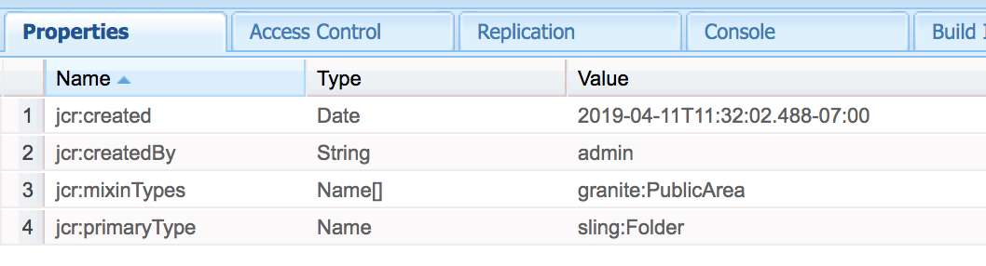
Repository Content Classification (/libs)
Public (granite:PublicArea mixin)
Can be
Overlaid
Inherited (sling:resourceSuperType)
Used directly (sling:resourceType)
Nodes marked as Public under /libs will be upgrade-safe
Customer apps should only leverage nodes marked as Public
Notes:
/libs is part of the AEM release and therefore cannot be changed by deployment of the customer application.
In order to make it safer and easier for customers to understand what areas of /libs are safe to use, overlay and extend, the content in /libs has been classified with new mixins.

Slide 29
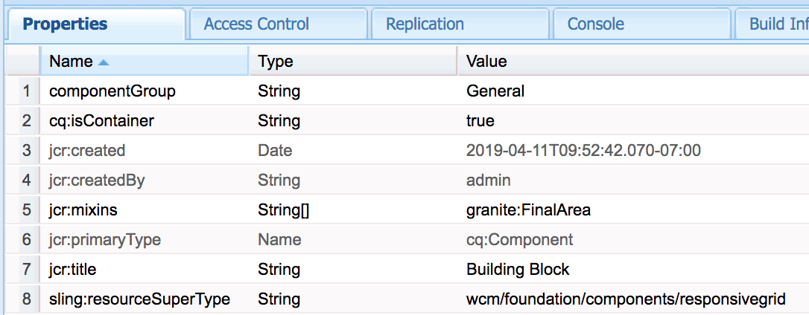
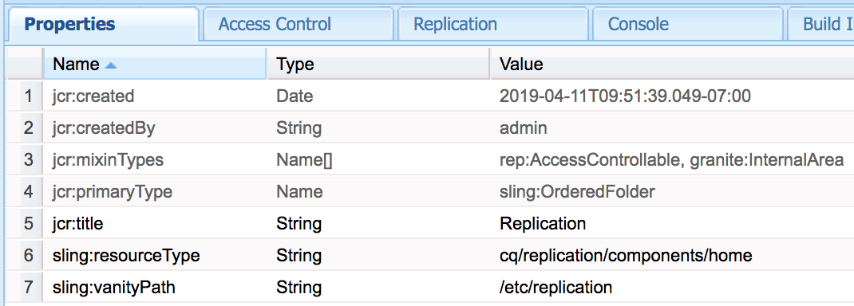
Repository Content Classification (/libs) (cont)
Final (granite:FinalArea mixin)
Cannot be overlaid or inherited
Can use directly (sling:resourceType)
Children of Final nodes are considered Internal by default
Internal (granite:InternalArea mixin)
Cannot be overlaid, inherited, or used directly
Internal functionality of Experience Manager

Slide 30
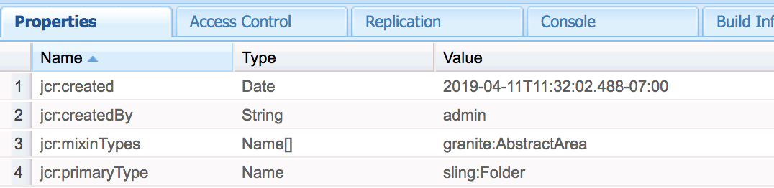
Repository Classification (cont.)
Abstract (granite:AbstractArea mixin)
Can be overlaid or inherited
Must not be used directly
No annotation
Inherit classification base on the tree hierarchy
Notes with parent classified as Internal or Final are treated as Internal

Slide 31
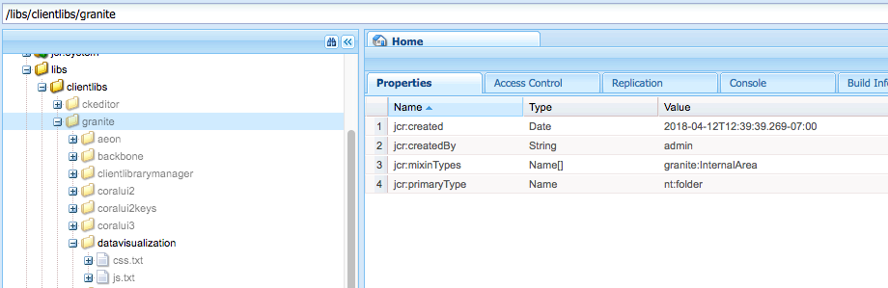
Repository Classification (cont.)
Granite:InternalArea
Visual Cue:
Grayed Out

Slide 32
Apache Sling Context-Aware Configuration
Application support for different contexts and configurations for each of those contexts
Different contexts = sites, regions and tenants
Some parameters may be shared among contexts, inheritance for nested contexts and from global fallback values supported
Code should make no assumption on how context-aware configurations are searched or stored
Notes:
Context-aware resources
Context-aware configuration
https://sling.apache.org/documentation/bundles/context-aware-configuration/context-aware-configuration.html

Slide 33
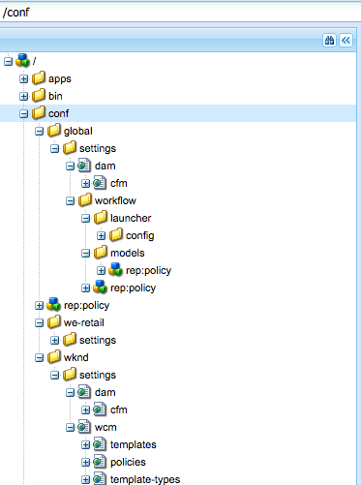
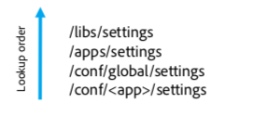
Context-Aware Configuration
Content in one part of the repository can be overlaid multiple times by content in other parts of the repository
For example:
Content in /libs/settings can be overlayed by content in /apps/settings
Content in /apps/settings can then be overlayed by content in /conf
Content in a global folder under /conf can be overlaid by a specific "tenant”, "site”, or “app” (for example, /conf/we-retail/settings)

Slide 34
Apache Sling

Slide 35
The REST Architecture
REST is a software architecture style for distributed hypermedia systems such as the World Wide Web
Application data and state are represented as a set of addressable resources
Resources present a uniform interface
The interface allows transfers of state, for example, reading and updating of a state
An example of RESTful architecture is the web
Resources have URIs
Uniform interface is HTTP
Apache Sling is RESTful
Notes:
For more information on REST architecture, refer to the link: https://en.wikipedia.org/wiki/Representational_state_transfer

Slide 36
Introduction to Apache Sling
Key principles:
Web application framework
Content-oriented (JCR-based) application development
RESTful
Sling is resource-oriented, where every resource has a URL.
Processing of a request is done by:
Checking whether the URL resolves to a content object (resource) for which a script can be found to render the content
Mapping a JCR node to the resource
Notes:
Sling assumes that ‘Everything is a Resource’. That is, Sling is resource oriented, where the resources have URLs, and each resource is mapped into a JCR node. A request URL is first resolved to a resource, and then based on the resource, it selects the Servlet or script to handle that request. Servlets and scripts are handled uniformly in that they are represented as resources themselves and are accessible by a resource path. This means that every script, Servlet, filter, error handler, and so on is available from the ResourceResolver just like normal content—providing data to be rendered on request.
NOTE: The script for resource mapping is located from the sling:resourceType property, in combination with certain parts of the request (for example, selectors and/or extension).
NOTE: The ResourceResolver is the part of Sling that resolves incoming requests to actual or virtual resources.

Slide 37
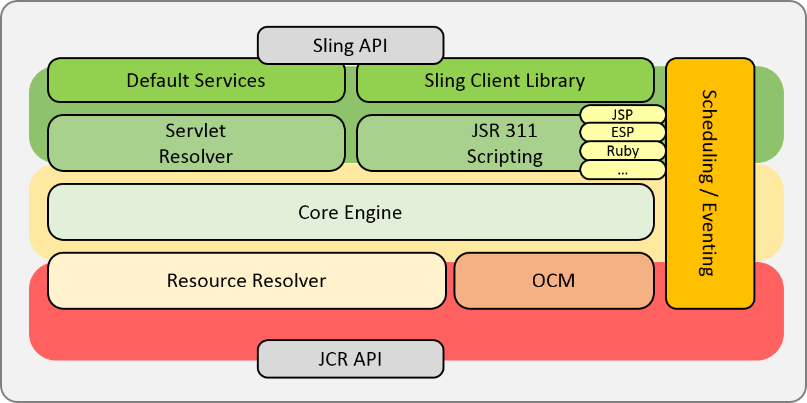
Understanding the Sling Framework

Slide 38
Decomposing the URL
Example:
URL: http://myhost/tools/spy.printable.a4.html/a/b?x=12
where:
Protocol: Is the Hypertext Transfer Protocol (HTTP)
Host: Is the name of the website
Content path: Is the path specifying the content to be rendered
Selector(s): Is used for alternative methods of rendering the content
Extension: Is the content format that also specifies the script to be used for rendering
Suffix: Can be used to specify additional information
Param(s): Are any parameters required for dynamic content
Protocol | Host | Content path | Selector(s) | Extension |  | Suffix |  | Param(s)
http:// | myhost | Tools/spy | .printable.a4 | html | / | a/b | ? | X=12

Slide 39
Rendering Scripts
Order of script preference:
selector.ext.html
selector.html
ext.html
default-script.html (name of component)
method.html
Notes:
All scripts are stored in either /apps or /libs folder, and are searched in the same order. If no matching script is found in either of the folders, then the default script is rendered. When the resource is identified from the URL, its resource type property is located and the value extracted. This value is either an absolute or a relative path that points to the location of the script to be used for rendering the content.
For multiple matches of the script, the script with the best match is selected. The more selector matches, the better.

Slide 40
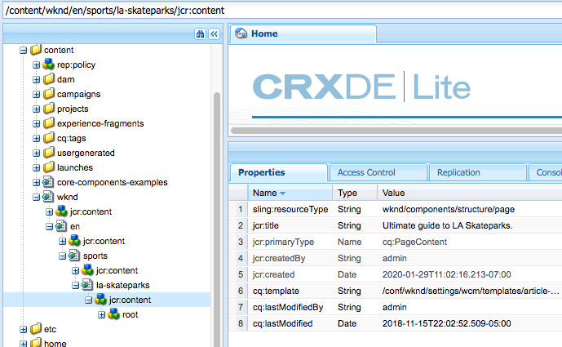

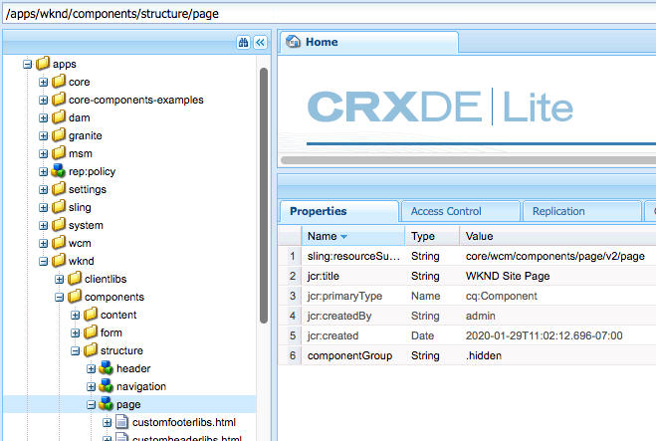
Understanding Sling
1
2
3
Notes:
1 Decompose URL
2 Follow sling:resourceType to find script
3 Render page and all contained components

Slide 41
Application Services

Slide 42
AEM 6+ Replication Overview
Serialized background transfer of data between AEM instances
Tight integration between replication agent and target publish instance
Based on Sling jobs
Multiple agents run independently
Tight integration into authoring UI (replication status)
Publish
Author
Content
JCR
Publish
ReplicationAgent
Queue
JCR
Publish
JCR

Slide 43
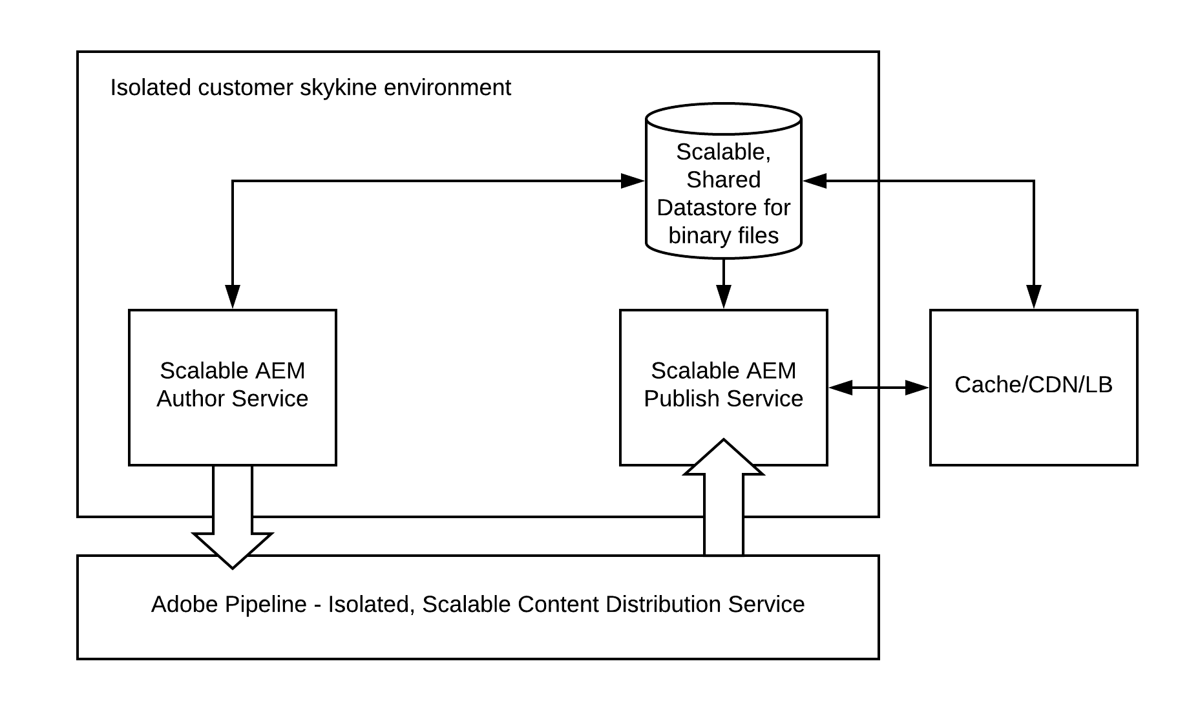
AEM as a Cloud Service Content Distribution
Sling Content Distribution is used to move the content to a pipeline service run on Adobe I/O that is outside of the Experience Manager runtime:
Automated
Auto-configures itself during runtime when when publish nodes are added or removed
Publication/Unpublication, to all publish instances, is atomic
Notes:
Traditional AEM replication framework used AEM 5.0 – 6.5
Publish tier auto-configures itself during runtime when when publish nodes are added or removed. Further when author server nodes are add or removed or recycled.
Publication/Unpublication is atomic, in that a single un/publication request will succeed for all resources in the AEM Publish Service, or fail for all. The resources within the AEM Publish Service will never be in a inconsistent state.

Slide 44
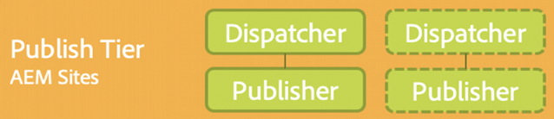
Webserver/Dispatcher
Traffic goes through an apache web server, which supports modules including the dispatcher
Dispatcher
Used primarily as a cache to limit processing on the publish nodes in order to increase performance
Also provides a security layer

Slide 45
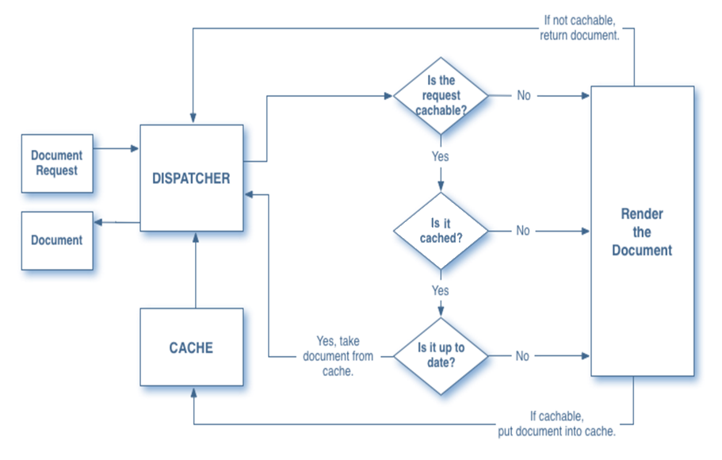

Dispatcher Caching Algorithm
PUBLISH
45

Slide 46
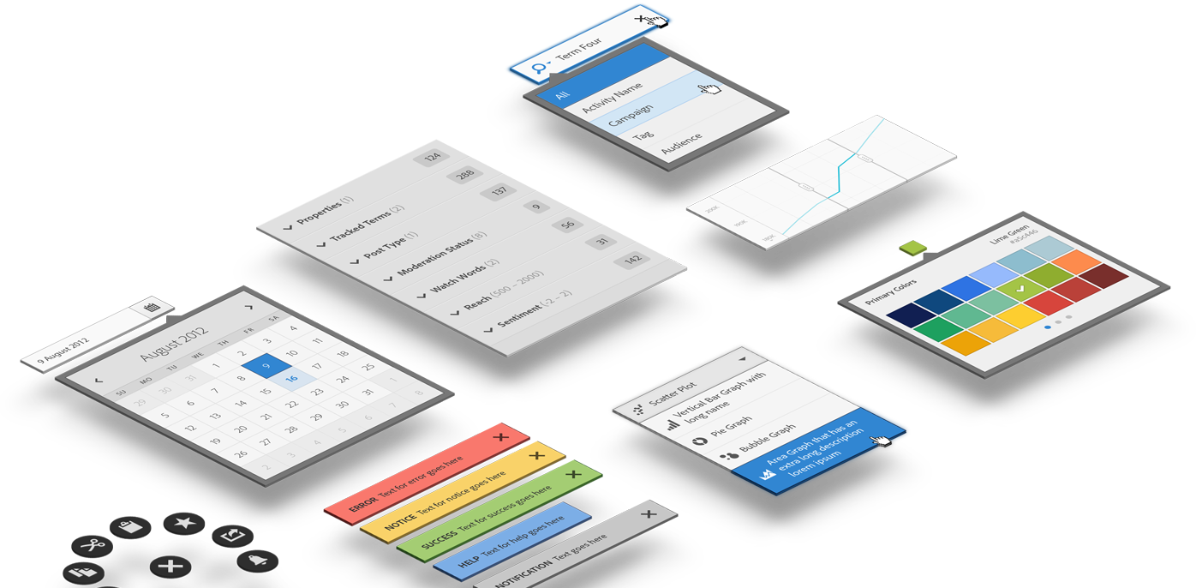
Coral / Granite UI
Coral UI
A touch-first, front-end framework for Adobe Cloud experiences
A set of CSS and JS components designed and built for Adobe Cloud products
Made up of component modules that can be consumed individually, allowing you to take just what you need

Slide 47
Coral / Granite UI (cont)
Granite UI
An umbrella name for UI projects to build a LEGO® architecture for UI, so that one can build complex webapps with much less code.
Lego Architecture
Modular, composable, layerable, reusable components
Independent evolution of components
Uniform way of doing things

Slide 48
Key Takeaways
Adobe Experience Manager Cloud Service Architecture now enforces a complete separation of application content from application code and configuration
Code and configuration is practically immutable and baked into the baseline image used to create the author and publish services
Changes to code and configuration can only be made by running Cloud Manager pipeline
Publishing operations
Experience Manager 6.5+ replication agents configured to replicate to a single publish instance
Adobe Experience Manager as a Cloud Service now follows a subscription pattern implemented by the Adobe Pipeline and Sling Content Distribution

Slide 49
Resources
Architecture Documentation
https://experienceleague.adobe.com/docs/experience-manager-learn/cloud-service/underlying-technology/introduction-architecture.html?lang=en#underlying-technology
https://docs.adobe.com/content/help/en/experience-manager-cloud-service/core-concepts/architecture.html
https://docs.adobe.com/content/help/en/experience-manager-cloud-service/implementing/home.html
https://docs.adobe.com/content/help/en/experience-manager-cloud-service/operations/home.html
Notes:
Note to CDs
For watching the Connect recording on ‘Tips for creating a great presentation’, you may need to download the Flash player, if it’s not downloaded already.

Slide 50
Content Migration

Slide 51

Migration to Experience Manager - Understanding Data Migration
Data migration is migration from legacy systems to the new system, in this case, AEM
Involves a detailed study of the architecture of the old system and the new system
Legacy systems:
Could be single or disparate
Could have their own Content Management Systems (CMS)
Notes:
Data Migration
Data migration is migration from legacy systems to new system, in this case, AEM
Involves a detailed study of its architecture
Legacy systems:
could be single or disparate
could have their own Content Management Systems (CMS)

Slide 52
The Migration Process
THE MIGRATION PROCESS
The Process:
Identify the source.
Transform the source to target format.
Import into repository.
Two approaches to migration:
One-time migration
Continuous migration
Types of migration:
Automated migration
Partially automated migration
Manual migration
Migration on request
Identify
Transform
Import
Notes:
To migrate data from legacy systems, it is best practice to follow these procedures:
Identify the source. Most legacy systems are based on databases and have relations between the data being stored. You need to extract this data from the source format into a neutral format. For example, you can extract the data into an xml format.
Transform the existing content to the target format. The extracted data needs to be converted into a format (an xml format) that is recognizable by AEM. That is, it should translate itself into nodes and properties as identified by the JCR. You need to use David’s model to map data into the JCR repository. We will talk about David’s model more in Chapter 4.
Import into CRX. Import and store the content in CRX using tools such as FileVault, or Package Manager.
As a final note, whenever you need to migrate content, consider the following:
Migration does not mean just copying and pasting data into CRX
Type of migration plan to use differs with each project
Make good use of the xml format.

Slide 53
Migrating Data From Legacy Systems
Pre-Migration tasks:
Scrub your data
Obsolete product
pages/data
General Clutter
Old Press
Releases
Obsolete test pages/data
Outdated Marketing Campaign Landing Pages
Notes:
A good plan is imperative to success!
Detailed mappings from source to node type/node name(URI)/property name
Identified strategy for manual/automated migration
Identified strategy for manual/automated testing
Identified success criteria
Set the stage for a potential change in migration strategy and it’s affect on the plan

Slide 54
Migrating Data From Legacy Systems (cont)
Pre-Migration tasks (cont):
Plan your migration:
Analyze the source system
Define the source data architecture and all the special considerations for the migration
Understand the source system’s ability to export data
Define pre-format data considerations
Export options?
Data Format
Taxonomy?
Metadata?
Data Relationships
Data Types
Notes:
A good plan is imperative to success!
Detailed mappings from source to node type/node name(URI)/property name
Identified strategy for manual/automated migration
Identified strategy for manual/automated testing
Identified success criteria
Set the stage for a potential change in migration strategy and it’s affect on the plan

Slide 55
Migrating Data From Legacy Systems (cont)
Pre-Migration Tasks (cont):
Implementation considerations:
Define the data manipulation/transformation that needs to take place.
Consider breaking the migration process into sub-migrations.
Define the node/property structure for the new system.
Perform a test on dummy data before testing on real data.
Migrate
Tools: VLT, POST servlet, JCR/SLIN/WCM APIs
Notes:
Empahsize ways to migrate: VLT, POST servlet, JCR/WCM APIs
VLT – good for bulk, but no good error msg help, good when source exports XML
POST – adhock testing
APIs – repeatable, but long dev process

Slide 56
Identifying Cost Benefit
Based on the complexity and size of the migrating system, use any of the following three methods for migration:
Manual migration (human data entry)
Automated migration (using APIs)
Hybrid migration (combination of manual and automated)
Notes:
Based on the complexity and size of the migrating system, you can use any of the following three methods for migration:
Manual migration (human entry) Hire someone to enter the data into an AEM friendly format.
Automated migration (using APIs) Export data from legacy system as XML, then write a script to convert the data into a JCR friendly XML, and finally import that package into JCR.
Hybrid migration (combination of manual and automated) Import the bulk of the data through XML, and hire someone to update the data manually; for example, for adding metadata to modernize the data.

Slide 57
Sample Project Timelines
Base templates done
Feature complete
Development
Go Live
Technical Migration
Test
Cloud Environment
Infrastructure
Go Live
Dev
Stage/UAT
Prod
Power User Training
Author Template Training
Content
Go Live
Content Migration

Slide 58
What affects the migration timeline?
Business requirements
Constraints, success criteria, content to be migrated from legacy system
Implementation considerations
Data architecture, migration tool(s), migration approach, source, target, data manipulation,
Proof of concept?
Legacy data considerations (source)
Source data architecture, pre-formatting/manipulation of source data
Target considerations (CRX content structure)
Target content structure, Adobe best practices, performance

Slide 59
What affects the migration timeline? (cont)
Execution considerations
Time of execution, development team constraints, contingency plans, recovery process, team information flow
Quality assurance considerations
Success criteria, QA requirements, QA process (automated/manual/hybrid)
Project success measurement considerations
Vacation Days
Time Zone Differences
Holidays
Corporate Deadlines
Cultural Differences
Plans B, C, D

Slide 60
Content Migration Group Exercise
We will be looking at 3 case studies.
You have 1 hour to work on your assigned case study, then we will discuss them as a group.
Please feel free to ask any questions you might have.
Document your assumptions!! The accuracy of your solution will depend on the assumptions that you make.
For each case study you should define the following
Migration approach:
Automated/Manual/Hybrid
Content Structure of the target:
General content model – /content structure, Node types, properties
Other considerations:
Planning
POC?
QA
Timeline

Slide 61
Key Takeaways
Content Migration Process:
Identify the source.
Transform the source to target format.
Import into repository
Identify items that can affect the project timeline
Identify cost/benefit of migration method
Tools exist to help modernize website
Change from static to editable templates
Change from foundation components to proxy components

Slide 62
Resources
AEM Code Modernization Tools
https://opensource.adobe.com/aem-modernize-tools/pages/tools.html
https://experienceleague.adobe.com/docs/experience-manager-cloud-service/moving/refactoring-tools/asset-workflow-migration-tool.html?lang=en#refactoring-tools
AEM Cloud Transition Tools
https://experienceleague.adobe.com/docs/experience-manager-cloud-service/moving/cloud-migration/cloud-readiness-analyzer/overview-cloud-readiness-analyzer.html?lang=en#cloud-migration
Notes:
Note to CDs
For watching the Connect recording on ‘Tips for creating a great presentation’, you may need to download the Flash player, if it’s not downloaded already.

Slide 63
Headless Content Management

Slide 64
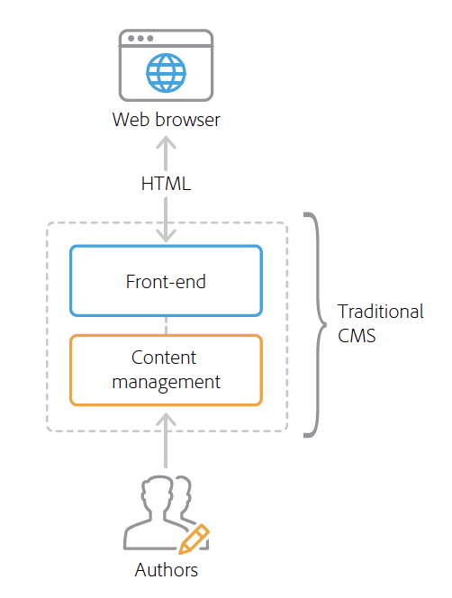
Traditional CMS Architecture
Manages and delivers content on a single technology stack
Minimizes total cost of ownership with efficient system maintenance and training
Controls all templating and presentation logic
Outputs fully formatted HTML
Often tightly coupled with a single channel
Results in a monolithic software architecture
Can make multichannel content delivery difficult and costly.

Slide 65
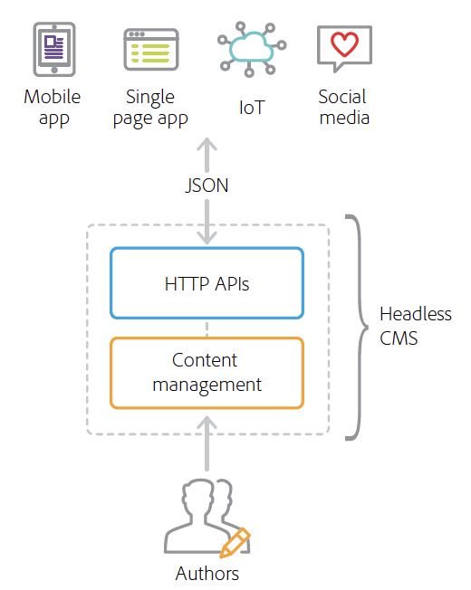
Headless CMS Architecture
Does not deliver HTML or formatted content directly
Decouples content from presentation
Enables content to be used by a variety of front-end technologies.
Exposes content through well-defined HTTP APIs
Note: The term ‘headless’ originates from the idea that the front-end presentation layer is the “head” of the application
Notes:
Headless CMS Cons:
This approach cuts marketers and authors out of presentation or layout decisions
Time to market and total cost of ownership increase, as any presentation changes require development support.

Slide 66
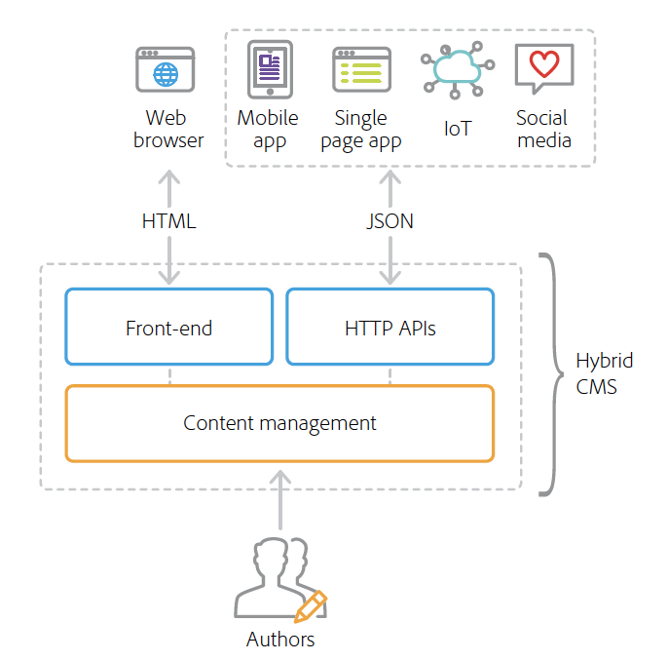
Hybrid CMS Architecture
Experience Manager takes a hybrid approach
Efficiency and ease of use of a traditional CMS
Flexibility and scalability of a headless development framework
Central hub to house and distribute content and experiences to any channel
Delivers content either as fully formatted HTML or as JSON over HTTP APIs
Brands choose between traditional or headless delivery
mix and match capabilities to meet their business needs

Slide 67
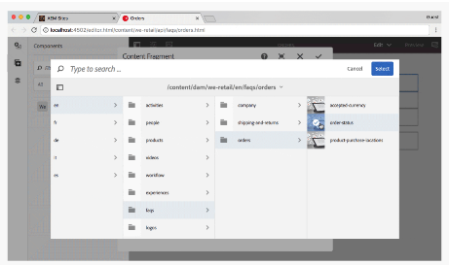
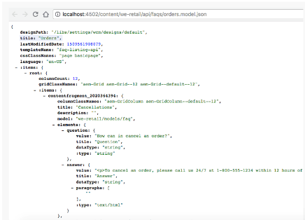
Hybrid CMS Architecture (cont)
AEM includes features that express content in a variety of formats through API endpoints:
Content services
Exposes content via HTTP APIs using a standard JSON schema, enabling brands to expose content to any channel without coding.
Sling Model Exporter
Allows developers to quickly render any Experience Manager content into JSON using custom business logic.

Slide 68
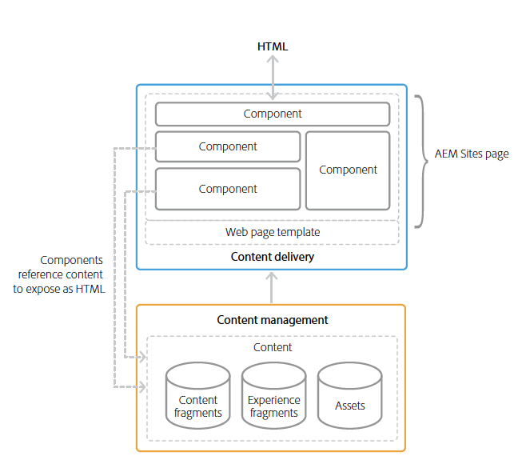
Multi-Channel Content Delivery and Content Services
To support all channels a CMS must expose the managed content in a multi-format and scalable way.
Standard formats for exposing web content:
HTML – language of the web browser
JSON – lightweight delivery format that powers modern connected applications

Slide 69
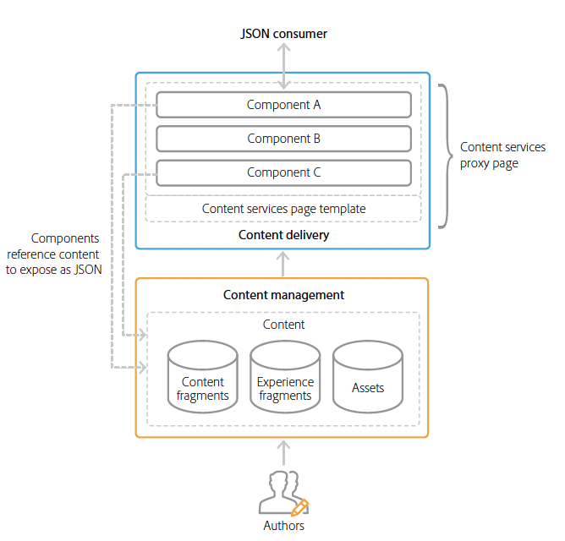
Experience Manager Delivery of HTML and JSON
AEM uses templates, pages, and components to compose content and deliver it via both HTML and JSON
Components can reference and reuse content abstraction features within the same channel or across channels :
Content fragments
Experience fragments
Assets

Slide 70
Sling Models
Preferred method for implementing the business logic of an Experience Manager component.
Supports both, HTML components and headless Content Management System (CMS).
Java objects that can be mapped to Sling resources.
Can export JSON objects
JSON objects are then used by programmatic web consumers such as other web services and JavaScript applications

Slide 71
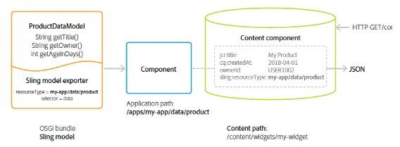
AEM Sling Model Exporter
Builds on the Sling HTTP web framework
Extension of Sling Models
Provides a mechanism for serializing Sling Model Java objects into any JSON format
Sling Models
Developed in Java as annotated POJOs
Represent some logical set of content or data

Slide 72
Experience Manager Single Page Application (SPA)

Slide 73
What is a Single Page Application (SPA)?
Differs from a conventional page in that it is:
rendered client-side
primarily Javascript-driven
relies on Ajax calls to load data and dynamically update the page
Content is retrieved once in a single page load
additional resources loaded asynchronously as needed based on user interaction
Reduces the need for page refreshes and feels like a native app experience

Slide 74
Enabling SPA with Experience Manager Site SPA Editor
Developers can build SPA experiences rapidly with popular JavaScript frameworks such as React and Angular
Typically using decoupled or “headless” CMS
AEM Sites
Enables developers by integrating with familiar frameworks and development tools
SPA Editor offers a WYSIWYG user interface that enables marketers and authors to make in-context changes to content, layout, and presentation, just as they would with traditional web pages
Notes:
Headless CMS Cons:
This approach cuts marketers and authors out of presentation or layout decisions
Time to market and total cost of ownership increase, as any presentation changes require development support.

Slide 75
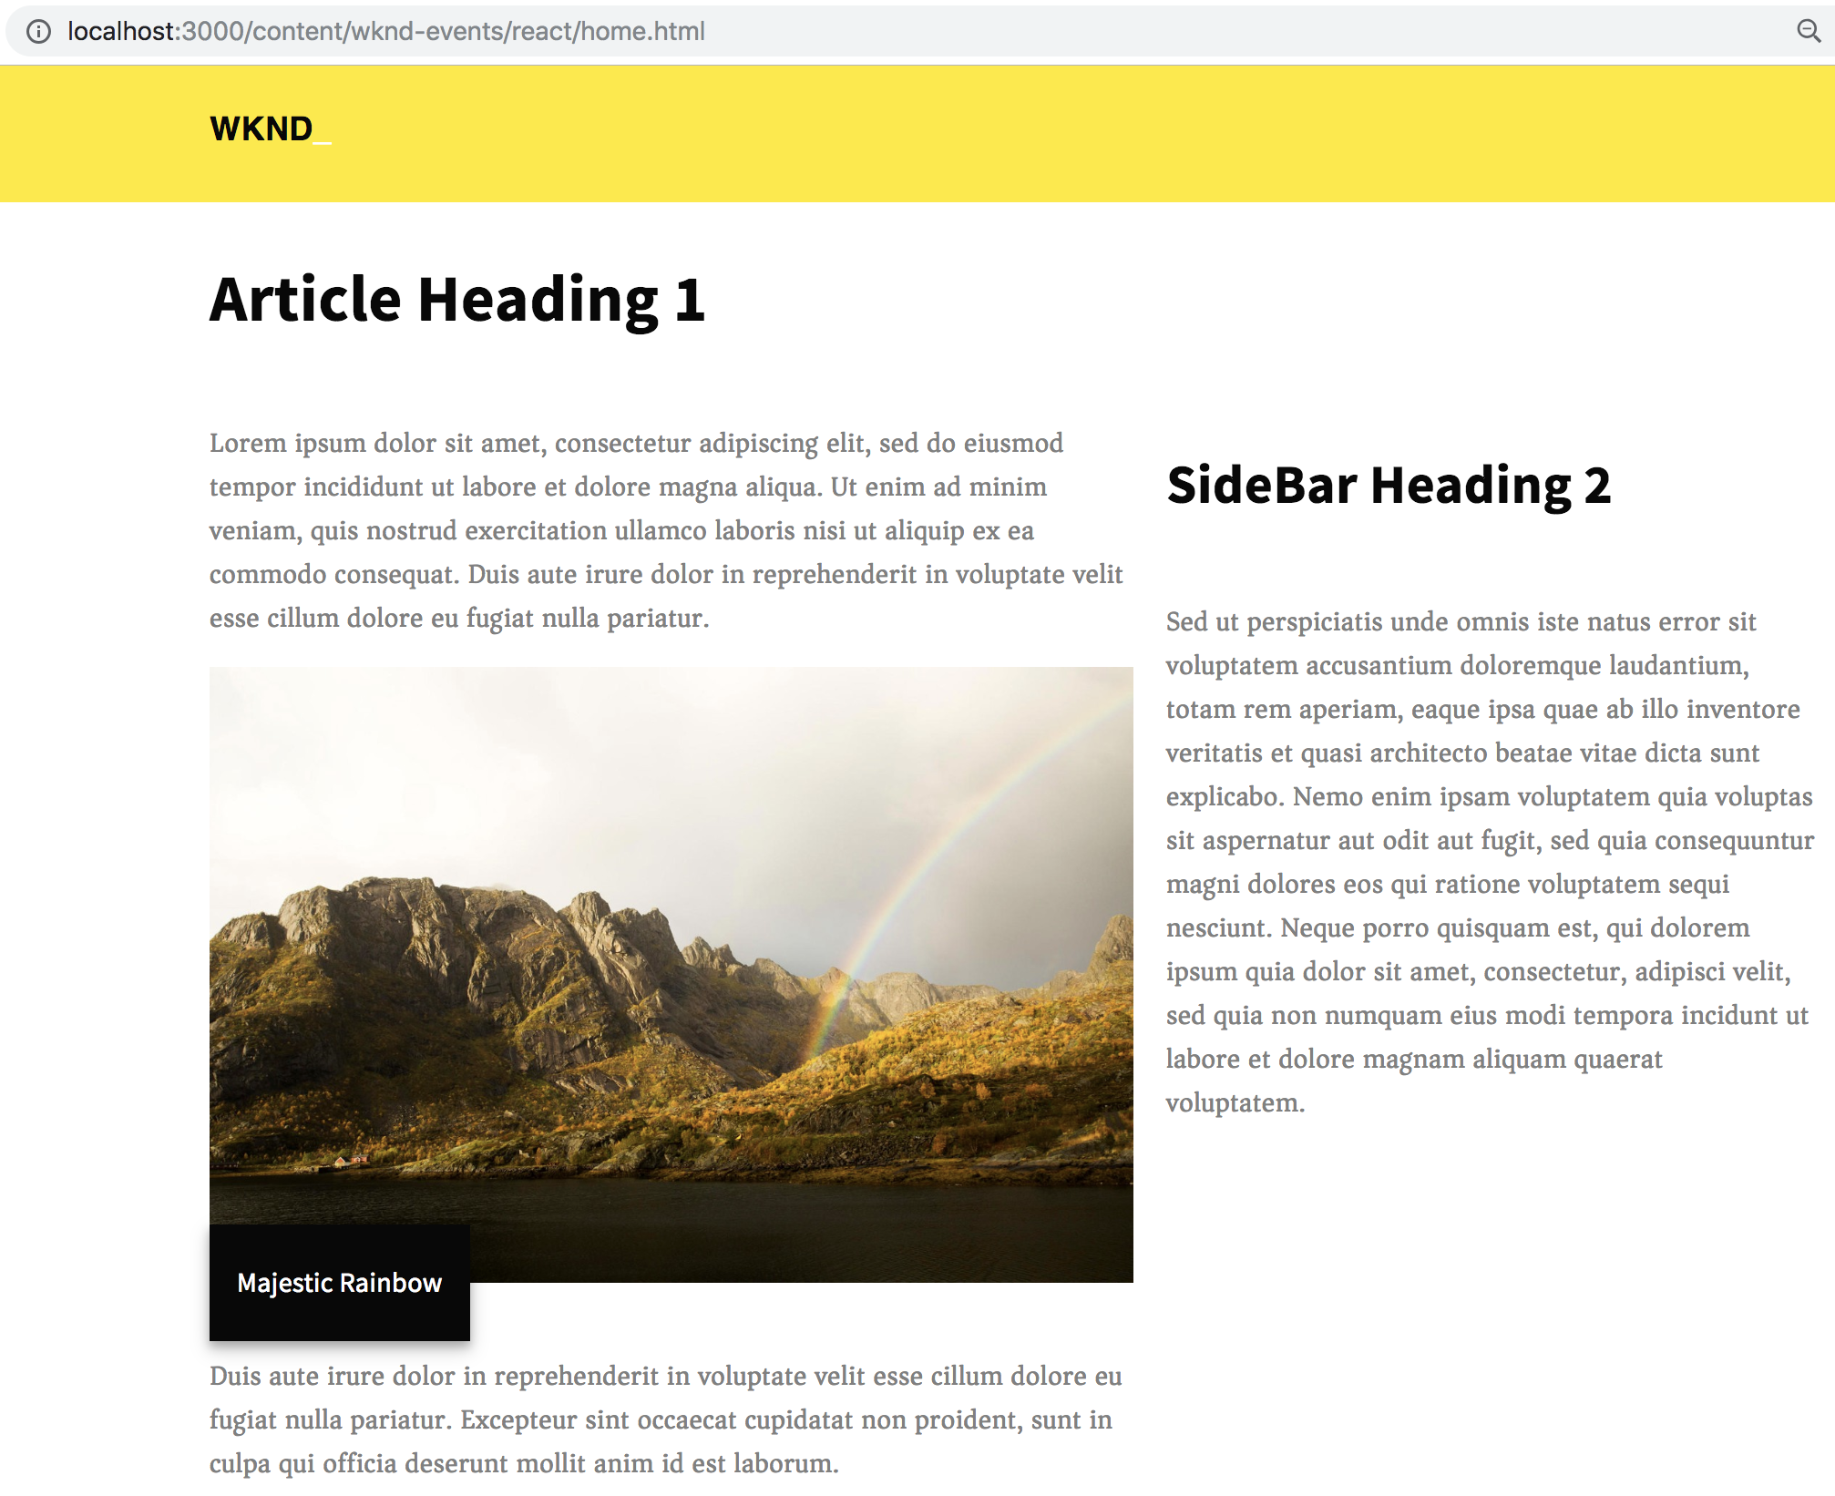
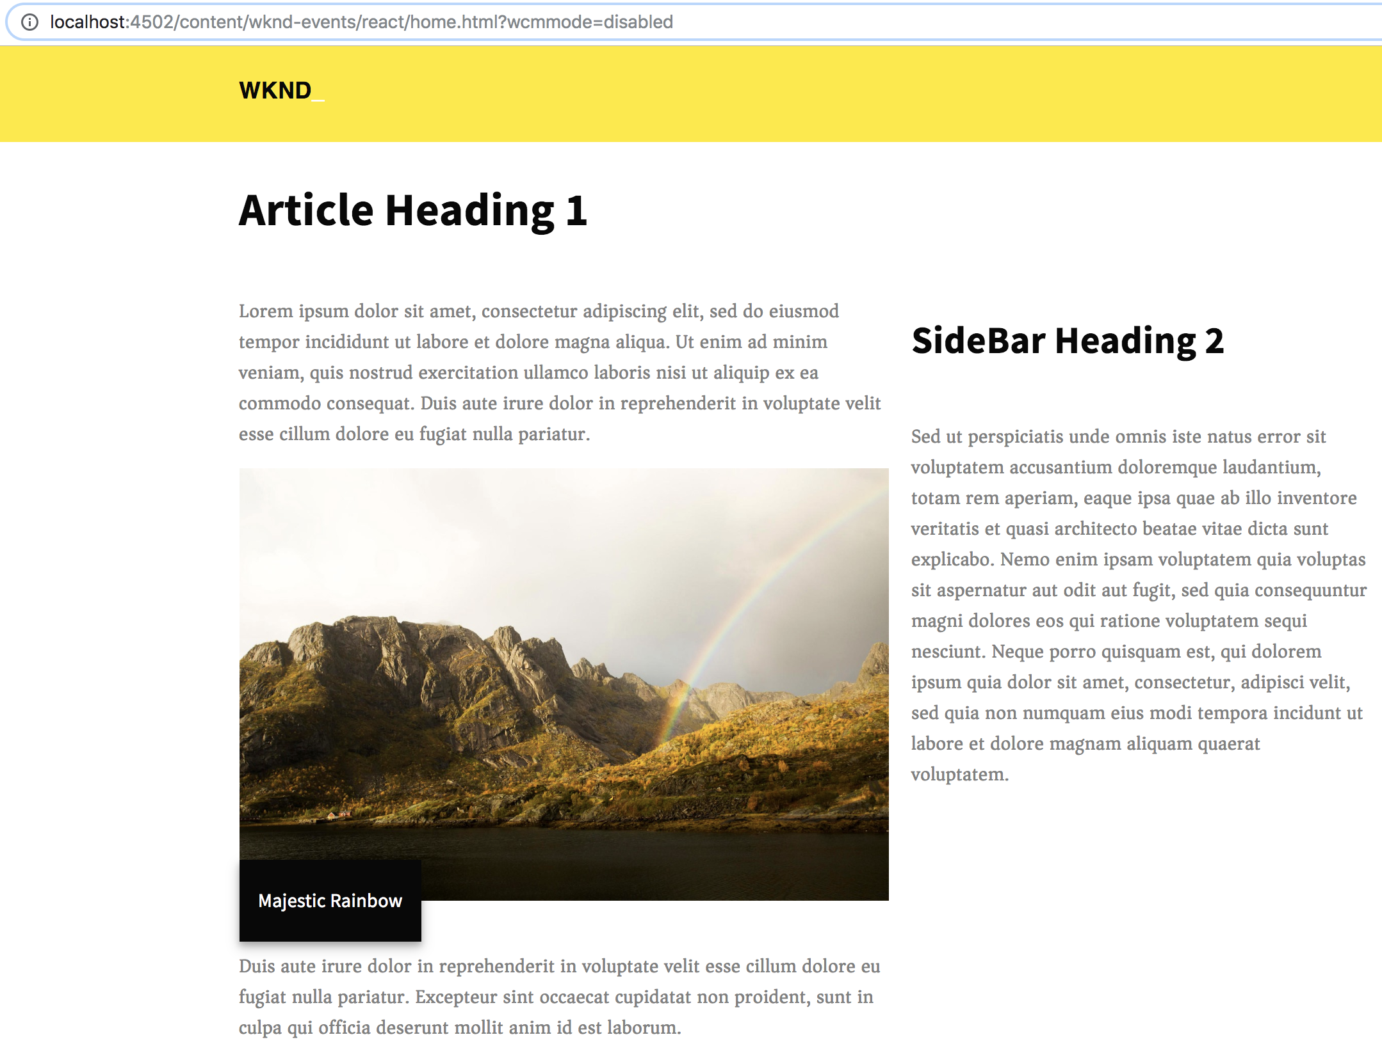
Experience Manager and SPA
Developers build sites using SPA frameworks
Authors seamlessly edit content within AEM for a site built using such frameworks
AEM instance and React/Angular Development Server render the same content
AEM instance and React/Angular Development Server render the same content
Notes:
Note: Archetype 23 has support for SPA in the front-end module.
Adobe’s new Single-Page Application (SPA) Editor in AEM Sites enables developers and marketers to preview, edit, and manage content in-context and in one place for faster collaboration.
Edit and manage single-page applications (SPAs) built on open-source frameworks like React and Angular with the same drag-and-drop editor you use for websites.
First shipped as part of AEM 6.4 SP2, with AEM 6.5 the SPA support gains following capabilities:
Use Template Editor to edit and configure the AEM editable parts of the SPA.
Use Multi-site Management to create country, franchise or white-labeled SPA experiences.

Slide 76
SPA Development Principles for AEM
Portability
Components should be built to be as portable as possible. The SPA should be built with portable and reusable components.
Experience Manager drives Site structure
Front-end developer creates components and owns their internal structure, but relies on AEM to define the content structure of the site
Dynamic Rendering
All rendering should be dynamic.
Dynamic Routing
SPA is responsible for the routing and Experience Manager fetches based on that routing. Routing should be dynamic as well.

Slide 77
AEM SPA Editor
Allows front-end developers to create SPAs
Using common front-end languages
That can be integrated into an Experience Manager site
Allows content authors to edit the SPA content as easily as any other Experience Manager content
Leverages Experience Manager Content Services to deliver the entire content of the page as a JSON model

Slide 78
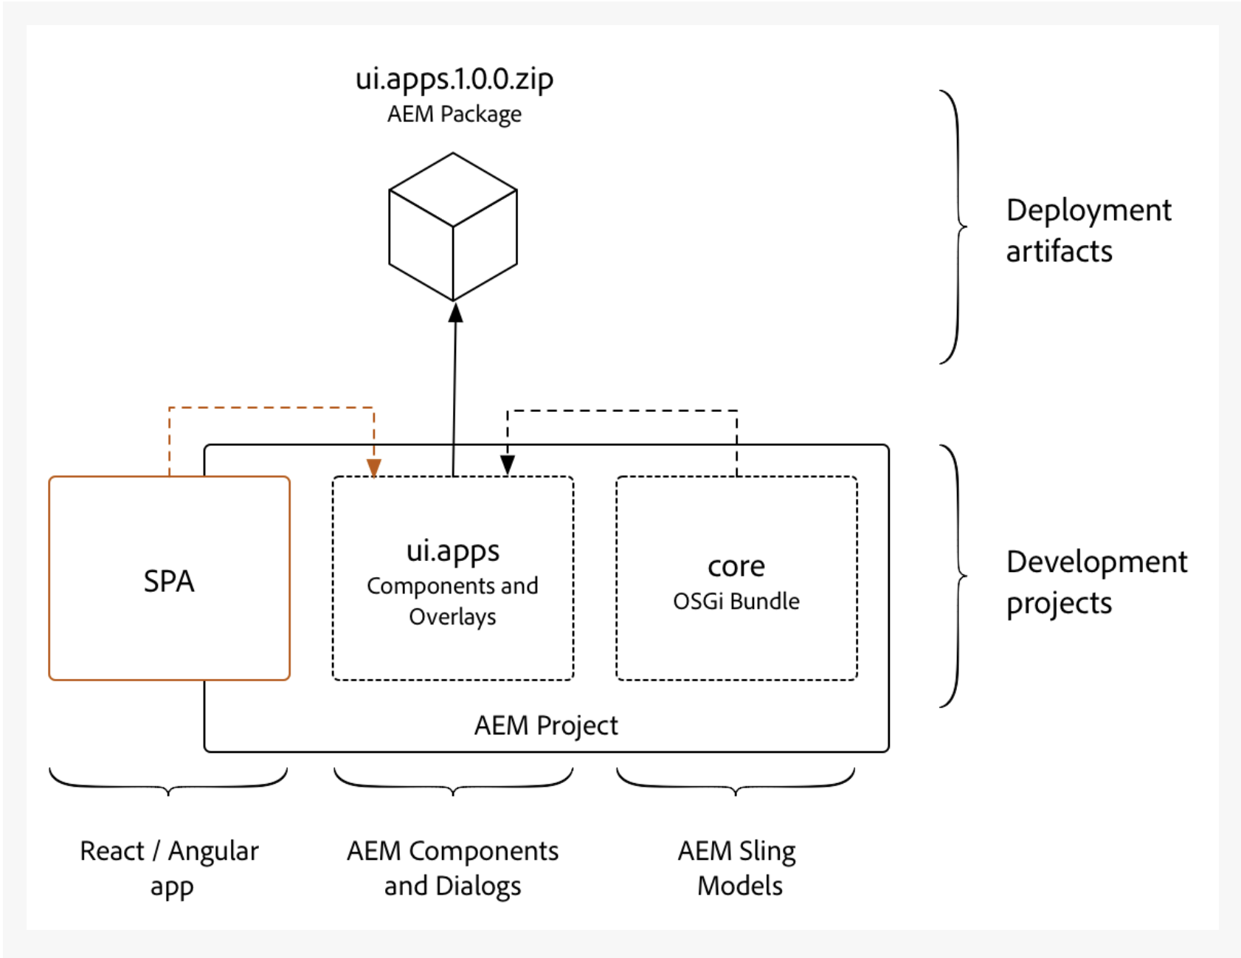
Implementation/Deployment Integration Approach
Development done in Webpack project
Compiled SPA copied into ui.apps as a client-side library
Deployed to Experience Manager as a content package
Notes:
The concept is similar to the integration of the core Java bundle, where the Java bundle is compiled into a jar file that is embedded into the ui.apps module and deployed to AEM as an AEM package.
Note: Supports both React and Angular. We are using React as an example here.

Slide 79
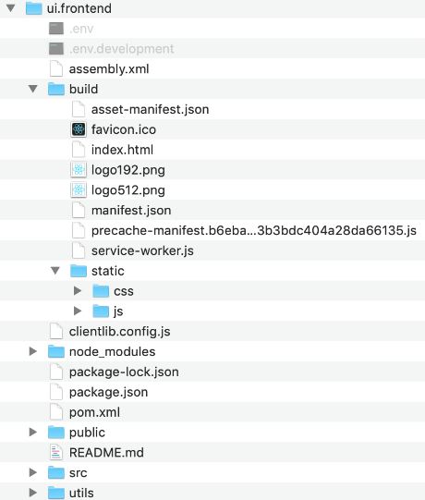
React build
Files created by npm run build
.js and .css files will be copied into an AEM clientlib by npm build process
Defines how Client Library will be generated
Defines dependencies & version. Defines scripts to run during build.
React component .js and .sass files
Notes:
Point out that the react code and all activities associated with react, npm and node.js are performed in the react-app module,

Slide 80
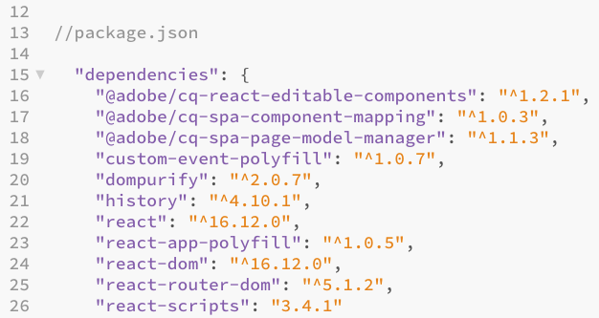
Experience Manager SPA Editor JS SDK dependencies
npm modules provided by Adobe
These 3 modules make up the AEM SPA Editor JS SDK

Slide 81
AEM SPA Editor JS SDK
Collection of JS libraries
Framework for editing contents of a SPA deployed in Experience Manager
Experience Manager delivers content as JSON and SPA Editor JS SDK maps the JSON to React components
Available via three npm modules:
@adobe/cq-spa-component-mapping - provides helpers to map AEM Components to SPA components. This module is not tied to a specific SPA framework.
@adobe/cq-spa-page-model-manager - provides the API to manage the model representation of the Experience Manager Pages that are used to compose a SPA. This module is not tied to a specific SPA framework.
@adobe/cq-react-editable-components - provides generic React helpers and components to support authoring. This module also wraps the cq-spa-page-model-manager and cq-spa-component-mapping to make these available to the React framework.

Slide 82
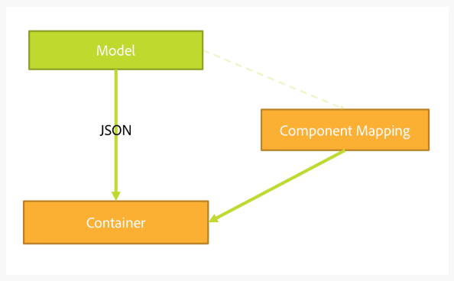
Page Model Management (cont)
For each resource in the exported model the SPA maps an actual component which will do the rendering
The model, represented as JSON, is then rendered using the component mappings within a container

Slide 83
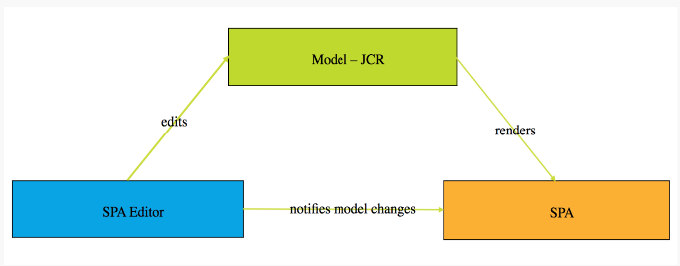
Communication Data Type
cq.authoring.pagemodel.messaging client library sends a message to the Page Editor to establish the JSON communication data type
When the communication data type is set to JSON, GET requests will communicate with the Sling Model end-points of a component.
After an update occurs in the page editor, a JSON representation of the updated component is sent to the Page Model library
Page Model library then informs the SPA of updates.

Slide 84
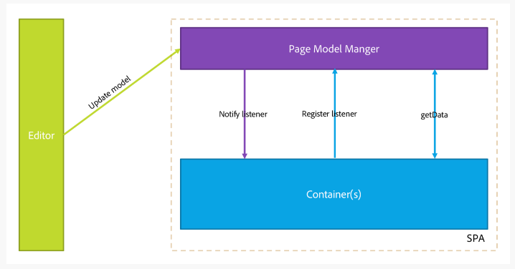
Flow of Interaction Between SPA and Experience Manager
SPA Editor is mediator
Communication between Page Editor and SPA is JSON, not HTML
Page Editor provides latest version of the page model to the SPA via iframe and messaging API
Page Model Manager notifies editor that it is ready and passes page model as a JSON structure
Editor does not alter or access the DOM structure of the page being authored, rather it provides latest page model.

Slide 85
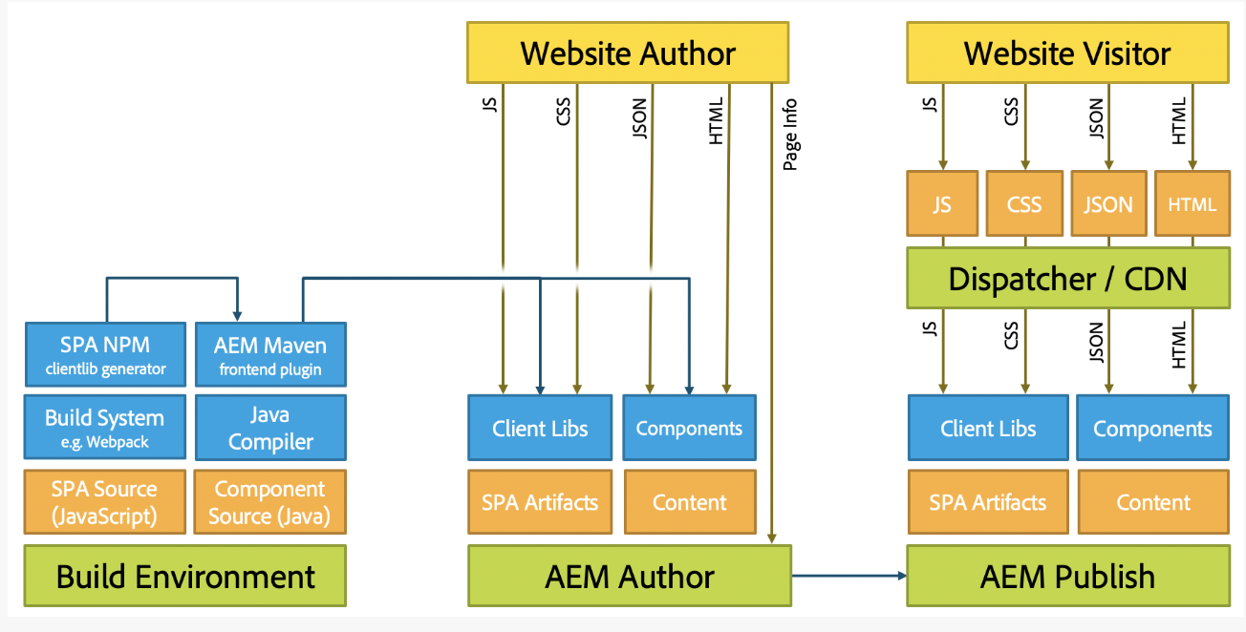
AEM Architecture and SPAs
Notes:
See https://helpx.adobe.com/experience-manager/6-5/sites/developing/using/spa-architecture.html for further explanation.

Slide 86
Heart of the React App
Index.js is the React app entry point and initiates connection to app CSS and the DOM
Initializes connection to Experience Manager json data for the app
ModelManager is provided by the Experience Manager SPA Editor JS SDK. It is responsible for calling and injecting the pageModel (the JSON content) into the application
App.js handles the view generation and component inclusion:
Main app JavaScript component
Container for all other components
Extends React’s Page class to define a page component
Notes:
**INFORMATIONAL side note: Index.js can also be used to load (via 'import' statement) the ../build/service-worker.js file -- often used in React to support Progressive Web Apps (PWA).
Index.js can be used to kick off the service-worker.js
Takes care of caching and updating files for the end-user
Allows for offline capability and faster page loads after the initial visit
Further detail on use of Service Workers:
https://stackoverflow.com/questions/47953732/what-does-registerserviceworker-do-in-react-js (registerServiceWorker is the older name of this file)
https://levelup.gitconnected.com/a-guide-to-service-workers-in-react-js-82aec1d6a22d
https://blog.bitsrc.io/using-service-workers-with-react-27a4c5e2d1a9

Slide 87
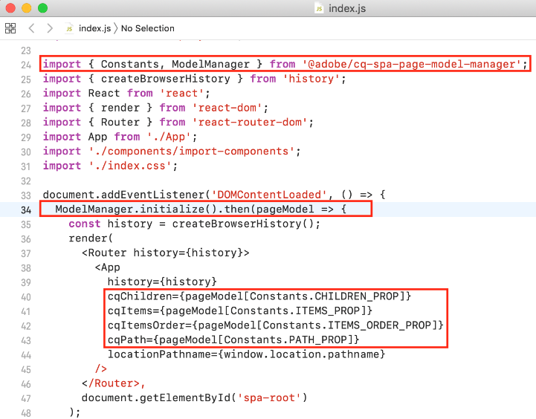
Integrate Experience Manager SPA Editor JS SDK – react-app/src/index.js
Initialize the App with AEM JSON Model
Initialize the App with AEM JSON Model
Initialize the App with AEM JSON Model

Slide 88
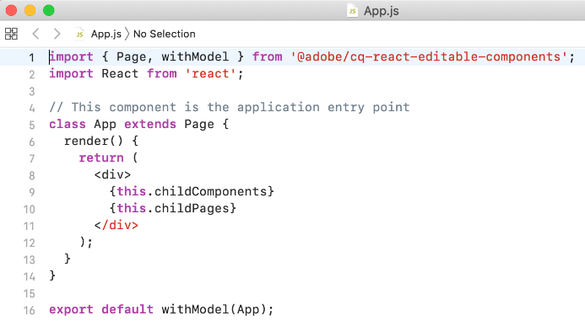
Integrate Experience Manager SPA Editor JS SDK – react-app/src/App.js
App.js extends Page class from @adobe/cq-react-editable-components
render() function this.childComponents and this.childPages include React components driven by JSON model
Notes:
Stopped here. Intro App.js and Index.js

Slide 89
ComponentMapping
Library provided as an NPM package
Stores front-end components
Provides a way for the SPA to map front-end components to AEM resource types:
Enables a dynamic resolution of components when parsing the JSON model of the application
Each item present in the model contains a :type field that exposes an Experience Manager resource type
Front-end component can render itself using the fragment of model it has received from the underlying libraries

Slide 90
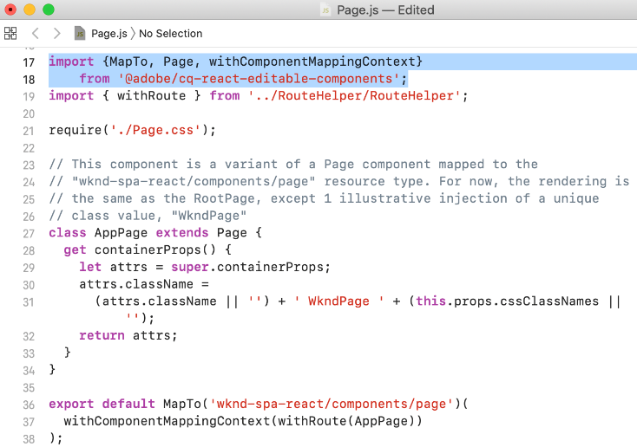
Integrate AEM SPA Editor JS SDK – react-app/src/components/page/page.js
Map AEM resource type
wknd-spa-react/components/page to a React component WKNDPage

Slide 91
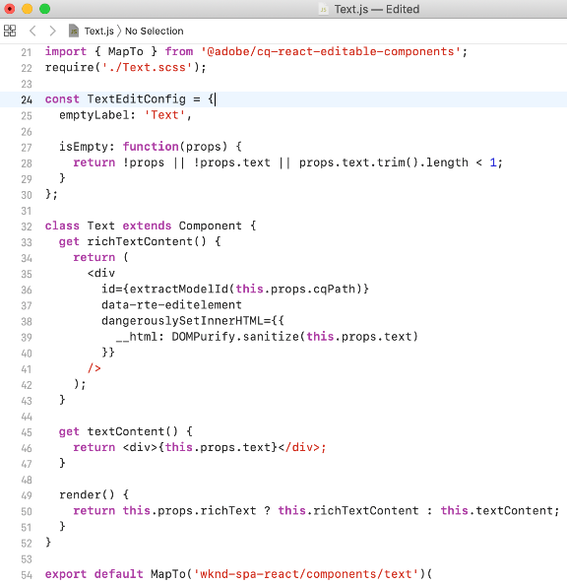
Text Component
Set up a default editConfig for the Text component
Map the AEM Text component to a React component that allows rich text authoring as part of the app
AEM properties available as React ‘props’
Notes:
Define editConfig’s purpose. Students new to AEM will not understand what it does.
It checks if there is any content in the component already added by the Author – if not, it displays the Component Placeholder with the Label specified in “emptyLabel” variable on line 25

Slide 92
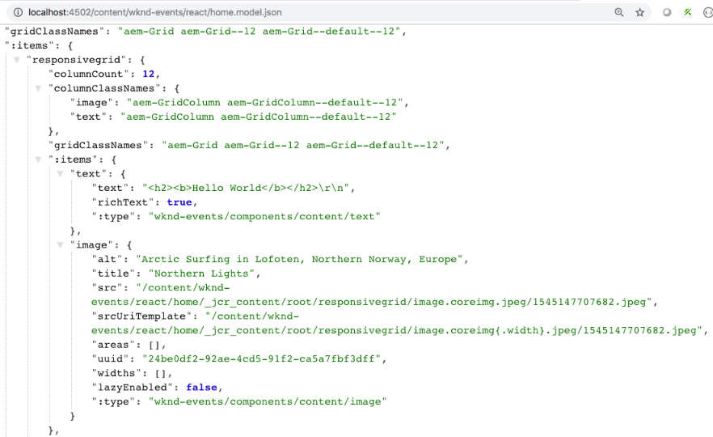
Image Component Model JSON Export
MapTo functionality exposes the JSON values of alt, title, src that can then be used by the React Image component.
Notes:
Needs updated with new screenshot

Slide 93
Key Takeaways
Experience Manager takes a hybrid approach
Delivers content either as fully formatted HTML or as JSON over HTTP APIs
Experience Manager includes features that express content in a variety of formats through API endpoints:
Content services – exposes content via HTTP APIs using a standard JSON schema, enabling brands to expose content to any channel without coding.
Sling Model Exporter – allows developers to quickly render any Experience Manager content into JSON using custom business logic.

Slide 94
Key Takeaways
AEM SPA Editor
Collection of JS libraries
Framework for editing contents of a SPA deployed in Experience Manager
AEM delivers content as JSON and SPA Editor JS SDK maps the JSON to React and Angular components

Slide 95
Resources
Experience Manager Headless
https://docs.adobe.com/content/help/en/experience-manager-learn/getting-started-with-aem-headless/overview.html
https://www.adobe.com/content/dam/www/us/en/marketing/experience-manager-sites/headless-content-management-system/pdfs/aem-hybrid-architecture-wp-1-18-19.pdf
https://docs.adobe.com/content/help/en/experience-manager-65/developing/components/json-exporter-components.html
Notes:
Note to CDs
For watching the Connect recording on ‘Tips for creating a great presentation’, you may need to download the Flash player, if it’s not downloaded already.

Slide 96
Resources (cont)
Experience Manager SPA Editor
https://docs.adobe.com/content/help/en/experience-manager-65/developing/headless/spas/spa-overview.html
https://docs.adobe.com/content/help/en/experience-manager-learn/sites/spa-editor/spa-editor-framework-feature-video-use.html
Experience Manager SPA Tutorials
https://experienceleague.adobe.com/docs/experience-manager-65/developing/headless/spas/spa-wknd.html?lang=en

Slide 97
Introduction to AEM as a Cloud Service

Slide 98
Adobe Experience Manager as a Cloud Service: What is it?
Next generation of the Experience Manager product line evolving into a cloud native solution
Provides Continuous Delivery and Continuous Integration for updates with zero downtime.
Delivers content quickly and efficiently, leveraging a built-in Content Delivery Network (CDN) and other network layer best practices
Is based on a dynamic architecture that autoscales, thus removing infrastructure considerations
Is security focused, using automated tests to scan for common vulnerabilities
Validates customer code using automated tests
Has performance topologies optimized for maximum resilience and efficiency
Is deeply integrated with the Adobe Experience Cloud
Notes:
From Orientation KT:
AEM Cloud Service introduces the next generation of the AEM product line. It builds on top of two decades of constant investments, preserving and extending all AEM use cases and functionalities, while turning the product into a cloud native solution.
The cloud native nature of the AEM Cloud Service allows for:
Developers can fully concentrate on configuring and extending AEM, following the same patterns that have made AEM successful over the years, augmented with new cloud-based development pattern
Business practitioners enjoy a better user experience with faster performance, and the latest innovations delivered to them regularly
Marketing professionals experience quicker time to value thanks to deeper integration within the Adobe Experience Cloud
System administrators don't have to worry about infrastructure and operations thanks for a fully automated service

Slide 99
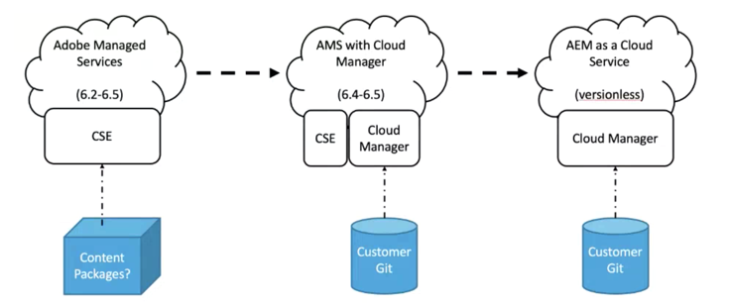
Evolution of support for Cloud Deployment

Slide 100
Adobe Experience Manager Cloud Service: Key Characteristics
1
Always On
2
Always Current
Best in class service level | No content freeze or downtime
Protection against cloud disasters and failures | Robust on-demand data storage
Continuous access to the latest innovations | Automated rolling product updates
3
Always at Scale
4
Always Learning
Ensure performance during peak hours of traffic by visitor and users | Auto-scaling (publish & author)
Faster rendering and processing of 100%-pixel quality assets | Microservices for assets ingestion and processing
Always up-to-date with performance enhancements and security updates | Automated corrective updates
Intelligence and machine learning by default | Native access to Sensei intelligence

Slide 101
Adobe Experience Manager Cloud Service: Runtime Architecture
Per Environment
CDN Service
Shared Service
Containers
Replication Service
Content Repository Service
CI/CD Service
Identity Management Service
Assets Compute Service
Container Orchestration Service
Notes:
Everything is a service
This architecture:
Is scaled based on the actual traffic and actual activity.
Has individual instances that only run when needed.
Uses modular applications.
Has an author cluster as default; this avoids downtime for maintenance tasks.
This enables autoscaling as necessary. AEM Cloud Service is based on the use of an orchestration engine that:
Constantly monitors the state of the service.
Dynamically scales each of the service instances as per the actual needs; both scaling up or down as appropriate.
AaaCS made available as individual instances with each instance representing a complete AEM environment. There are four types of environments available with AEM as a Cloud Service:
Production environment : hosts the applications for the business practitioners.
Stage environment : is always coupled to a single production environment in a 1:1 relationship. The stage environment is used for various performance and quality tests before changes to the application are pushed to the production environment.
Development environment : allows developers to implement AEM applications under the same runtime conditions as the stage and production environments.
Demonstration environment : can be used for evaluation, demonstration, prototyping, and training purposes.
The development and the demonstration environments are often referred to as non-production environments.
– more detail on the runtime architecture in a later module

Slide 102
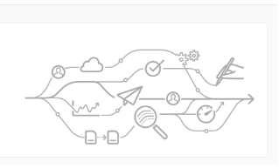
Cloud Manager
Essential component to Adobe Experience Manager Cloud Service
Single entry point for the operations and developer persona
AEM programs and environments managed from Cloud Manager
New tenants of the Adobe Experience Manager Cloud Service provisioned for Cloud Manager access
Controls and manages all updates to the instances of the AEM Cloud Service
Mandatory, and the only way to build, to test and to deploy the customer application both to the Author and the Publish services
Notes:
More on this topic later in the course

Slide 103
Cloud manager entities
Programs
Environments
Pipelines
Program: High-level entity, typically associated with a service level agreement (contract) that contains production and non-production environments
Cloud manager enables self-service creation of AEM applications (AEM Sites, AEM Assets) within a program
Environment: composed of an author tier and a publish tier. Cloud Manager environments typically have one production environment and one stage environment.
Cloud manager enables self-service creation of AEM environments (production and non-production)
CI/CD Pipeline: enables AEM project teams to quickly, safely and consistently deploy code to AEM environments
Cloud manager enables self-service creation of CI/CD pipelines that enforce best practices
Notes:
Transcript
Cloud Manager is an essential component to AEM as a Cloud Service.
Cloud Manager is the single entry point for the developer and system administrators to easily deploy code and manage environments.
Each new tenant of the AEM as a Cloud Service is first provisioned for Cloud Manager access.
Cloud Manager is in charge of all updates to the instances of the AEM Cloud Service. It is mandatory, and the only way to build, test, and deploy the customer application both to the Author and the Publish Tier.
These updates can be triggered by Adobe, when a new version of the AEM is ready, or by the Customer, when a new version of customer application is ready.
The User Interface (UI) for Cloud Manager enables customers to easily access and manage the cloud environment and other important components of AEM as a Cloud Service
One Such important component is program – in Cloud Manager – Programs are a set of environments that support a logical grouping of customer initiatives. Each program has exactly one production environment and may have multiple non-production environments.
Creating and managing entire new Programs.
Any new AEM project is always bound to exactly one particular codebase where customers can store both configuration and custom code for their project. This information is stored in a code repository, which is made available to our customers at the time new programs are created. This code repository can be accessed by usual Git clients.
With Cloud Manager, you can also create and manage AEM environments within these programs, as programs can contain multiple non-production environments.
Creating and managing the pipelines for deploying the customer code and configuration to a particular environment
Getting notified of important lifecycle events for these components (for example, product updates)
Cloud Manager includes a Continuous Integration (CI) and Continuous Delivery (CD) framework (CI/CD), which allows implementation teams to quickly test and deliver new or updated code. The CI/CD pipeline also automates unit and performance testing processes to increase deployment efficiency and pro-actively identify critical issues that are expensive to fix after deployment
Code Inspection, performance testing, and security validation based on best practices.

Slide 104
Adobe Experience Manager Cloud Service: Deployment Architecture
Customer Code Changes
Adobe Release Orchestration
Customer Code CI/CD
Code Building/Testing
Non-Production Environments
Baseline AEM Releases
Image Building
Stage Deployment
Adobe Release Validation
Security Testing
Stage Environment
Adobe Code CI/CD
Regression Testing
Adobe Code Changes
Performance Testing
Several Times a Day
Production Environment
Prod Deployment
Notes:
This slide is just an introductory slide. More detail later in CI/CD section
Fron Orientation KT:
Deployment Pipeline, coupled to each environment within a program. When a Cloud Manager pipeline is running, it aims at creating fresh new version of the customer application, both for the author and the publish tiers, by combining the latest customer packages with the latest baseline Adobe image. When the new images are built and tested successfully, Cloud Manager fully automates the cutover to the latest version of the image, by updating all service nodes using a rolling update pattern. This results in no down time for either the Author or Publish Service.

Slide 105
AEM as a Cloud Service Key Evolutions – Separation of Content from Code
Architecture completely separates the application content from the application code and configuration
All code and configuration is practically immutable and baked into the baseline image used to create the various nodes of the author and publish services
Absolute guarantee: Each node is identical
Changes to code and configuration can only be made globally by running a Cloud Manager pipeline

Slide 106
AEM as a Cloud Service Key Evolutions – Binary Content
Files (blobs) are directly uploaded and served from a cloud data store
Associated stream of bits never goes through the JVM of the Author and Publish services
Nodes of AEM author and publish services are smaller in size
Author and publish services more compatible with the expectation of fast autoscaling
results in a faster experience when uploading and downloading images, video, etc.

Slide 107
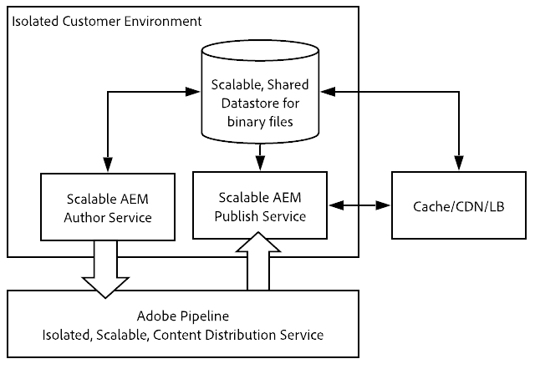
AEM as a Cloud Service Key Evolutions – Publishing Content
Publishing operations now involve a pipeline following a subscription pattern
Published content is pushed to various queues in the pipeline
Author tier does not need to be aware of the number of nodes in the publish service
Fast autoscaling of the publish tier

Slide 108
AEM as a Cloud Service Key Evolutions – Publish Service
Concept of a golden master introduced to automate the lifecycle of the publish nodes
Specialized publish node
Never accessed by any end user
Node from which all the nodes of the publish service are created
Maintenance operations such as compaction are performed on the content repository attached to the golden master
Publish nodes are recycled daily and do not require any sort of routine maintenance or downtime

Slide 109
Adobe Experience Manager Cloud Service: Runtime Architecture – Publish Tier
Per Environment
CDN Service
Shared Service
Containers
Replication Service
Content Repository Service
CI/CD Service
Identity Management Service
Assets Compute Service
Container Orchestration Service
Notes:
The Publish Tier is made of two or more nodes within a single Publish farm: they can operate independently from each other.
Each node consists of an AEM publisher and a Web Server equipped with the AEM dispatcher module. It scales automatically with site traffic needs.
End users, or site visitors, visit the website by hitting the AEM Publish Service
Publish service content delivery includes:
CDN (typically managed by Adobe)
AEM dispatcher
AEM publish

Slide 110

Content Delivery Flow – Essentially Unchanged
6
4
2
1
AEM Publish
Webserver/Dispatcher
CDN
7
5
3
8
Notes:
The data flow is as follows:
URL put in browser
Request made to CDN mapped in DNS to that domain
If content is fully cached on CDN, CDN serves it to the browser
If content is not fully cached, the CDN calls out (reverse proxy) to the dispatcher
If content is fully cached on dispatcher, dispatcher serves it to the CDN
If content is not fully cached, the dispatcher calls out (reverse proxy) to the AEM publish
Publish service returns content thru dispatcher
Content rendered by browser, which may also cache it, depending on headers

Slide 111
Adobe Experience Manager as a Cloud Service CDN Options
Adobe Managed CDN
Experience Manager's out-of-the-box CDN
Point to Adobe Managed CDN
Customer points a CDN to Experience Manager's out-of-the-box CDN
Notes:
AEM OOTB and managed CDN name – no need to share with the customer
#1 is highly recommended option since it is tightly integrated
Adobe cannot be responsible for the result of any misconfiguration of #2.
#2 and #3 will be allowed on a case-by-case basis based on meeting certain pre-requisites including, but not limited to, the customer having a legacy integration with their CDN vendor, which would be difficult to untie themselves from.
For #3 - Supported if customers want to use their existing CDN, but can't satisfy the requirements of Customer managed CDN. In this case, customers manage their own CDN, but point to Adobe's managed CDN.
Customers must:
perform and successfully pass a load test before going to production

Slide 112
CDN Cache Invalidation
In general, HTML content is cached in the CDN for 5 minutes
Client libraries are cached indefinitely.
Note: client libraries are served on a unique path that changes if the client libraries change. By default, images are not cached
Prior to accepting live traffic, customers should validate with Adobe customer support that the end-to-end traffic routing is functioning correctly.
Notes:
Cache invalidation follows these rules:
In general, HTML content is cached in the CDN for 5 minutes, based on the cache-control header emitted by the dispatcher
Client libraries (JavaScript and CSS) are cached indefinitely using the cache-control set to "immutable" or 30 days for older browsers who don't respect the "immutable" value. Note that the client libraries are served on a unique path that changes if the client libraries change. In other words, HTML that references the client libraries will be produced as needed so customers can experience new content as it is published.
By default, images are not cached
Prior to accepting live traffic, customers should validate with Adobe customer support that the end-to-end traffic routing is functioning correctly.

Slide 113
Key Takeaways
Adobe Experience Manager Cloud Service is the next generation of the AEM product line evolving into a cloud native solution
Adobe Experience Manager Cloud Service is
Always On
Always Current
Always at Scale
Always Learning
Cloud Manager is an essential component to Adobe Experience Manager Cloud Service and the only entry point for deploying Adobe Experience Manager Cloud Service applications

Slide 114
Resources
AEM Cloud Service Documentation
https://docs.adobe.com/content/help/en/experience-manager-cloud-service/core-concepts/home.html
https://docs.adobe.com/content/help/en/experience-manager-cloud-service/overview/terminology.html
https://docs.adobe.com/content/help/en/experience-manager-cloud-service/overview/what-is-new-and-different.html
https://docs.adobe.com/content/help/en/experience-manager-cloud-service/assets/overview.html
https://docs.adobe.com/content/help/en/experience-manager-learn/cloud-service/overview.html

Slide 115
Experience Manager Projects

Slide 116
Experience Manager Project Code Flow (AMS and AEM Cloud Service)
DevOps persona
Program
AEM Environment
Code/Content in Maven Project
Cloud Manager
Author
Publish
LB
via browser
<app>
<app>
Git
Git
Dispatcher
Notes:
These next slides are overview only – more detail in the CI/CD section.
Customer Git → Cloud Manager Git → Multiple Pipelines → An AEM Environment is an entire deployment → Access to Cloud is managed

Slide 117
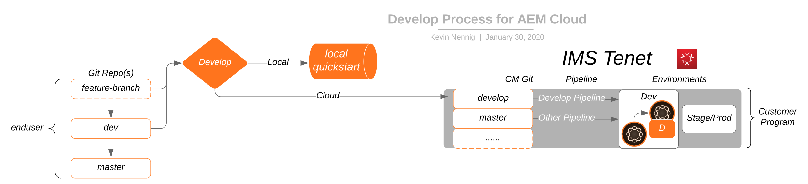
General Process for AMS and Adobe Experience Manager Cloud Service
Code is managed in a customer git repo
Normal development occurs
Branches can then be pushed into the CM git for Cloud
Code is tested in non-production before moving to production
Developer persona
IMS Tenant
DevOps persona
Notes:
These next slides are overview only – more detail in the CI/CD section.

Slide 118

Non-Production
Customer’s Git
(origin)
CM Git
(adobe)
master
develop*
master
develop*
Non-production Pipeline
Pass!
Dev Environment
Code Quality only
Author
Service
Publish
Service
Dispatcher
A develop branch can be setup on CM git that would facilitate non-production activities such as loading into the Dev Environment
Adobe Pipeline

Slide 119
Production
Customer’s Git
(origin)
CM Git
(adobe)
Production Pipeline
master*
develop*
master*
develop*
Validate
Then
Stage Environment
Prod Environment
Once a release candidate is chosen, code can be merged into Master. Master can be hooked up to a different pipeline for production. Production will pass through Stage and Prod Environments
Author
Service
Publish
Service
Dispatcher
Author
Service
Publish
Service
Dispatcher
Adobe Pipeline
Adobe Pipeline

Slide 120
AEM Cloud Service Environments: Local vs Dev vs Stage vs Prod. ***
Capability | Local Dev | Cloud Dev Author | Cloud Dev Pub | Cloud Stage and Prod - Author | Cloud Stage and Prod - Publish
Access to admin user | Yes | No | No | No | No
CRXDE Light | Yes | Yes (limited) | No | No | No
Package Manager UI | Yes | Yes (limited) | No | Yes (limited) | No
SSL Configuration UI | Yes | auto-config | auto-config | auto-config | auto-config
***May differ as AEM Cloud Service evolves
Notes:
CRXDE Limited: cannot make changes to immutable content: /apps, /libs
Package Manager Limited: can’t install packages that make changes to /apps, /libs

Slide 121
AEM Cloud Service Environments: Local vs Dev vs Stage vs Prod (cont) ***
Capability | Local Dev | Cloud Dev Author | Cloud Dev Pub | Cloud Stage and Prod - Author | Cloud Stage and Prod - Publish
Asset Processing on upload and update | DAM Update Workflow | Asset Compute | None | Asset Compute | None
Page Editor/Developer Mode | Yes | No | N/A | No | N/A
Publish Content | Replication agents Classic UI Replication Configuration UI | Sling Content Distribution – auto-configuration | No | Sling Content Distribution – auto-configuration | No
***May differ as AEM Cloud Service evolves
Notes:
Limited: cannot make changes to immutable content: /apps, /libs

Slide 122
Local Development

Slide 123
Local Development - Introduction
Fundamentals of code development for Adobe Experience Manager Cloud Service are similar to prior releases of Experience Manager:
Developers check out code from source control
Developers write code and test it locally
Tested code is checked in to local source control
Cloud Manager
Code pushed to Cloud Manager git repository
Code sent into the pipeline for remote Adobe Experience Manager Cloud environments
Cloud Manager is the sole mechanism for deploying code to Adobe Experience Manager Cloud environments

Slide 124
AEM Cloud Service Version Updates vs Deployed Customer Code
Experience Manager version updates and release orchestration are separate deployment events from pushing customer custom code:
Updates that happen after customer code has been deployed are automatically applied
Version updates are intended to be backwards compatible with the customer code already deployed
Custom code releases should be tested against the Experience Manager version that is on production

Slide 125
AEM Cloud Service: Deployment Architecture
Customer Code Changes
Adobe Release Orchestration
Customer Code CI/CD
Code Building/Testing
Non-Production Environments
Baseline AEM Releases
Image Building
Stage Deployment
Adobe Release Validation
Security Testing
Stage Environment
Adobe Code CI/CD
Regression Testing
Adobe Code Changes
Performance Testing
Several Times a Day
Production Environment
Prod Deployment
Notes:
Note: on prem deployments will follow the customer’s defined processes

Slide 126
Maven
Open source development tool used to build and manage Java-based projects.
It describes how software is built, as well as its dependencies
Has a central repository from which it can dynamically download Java libraries and plug-ins
Configured using Project Object Model (POM) files.
Advantages
Build process is easier (after the project is set up properly)
Provides a uniform build system
Provides quality project information
Provides guidelines for development best practices
Allows transparent migration to new features

Slide 127
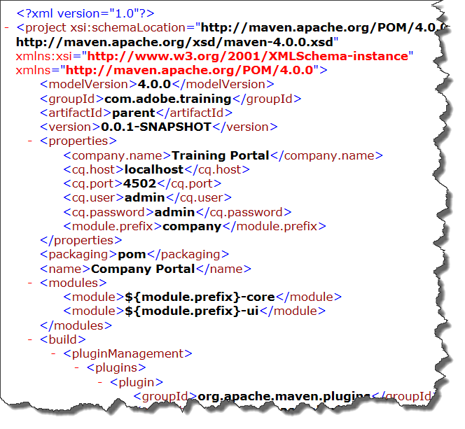
Contents of a POM File
POM files are XML files that contain the identity and structure of the project, build configuration, and other dependencies
A POM file contains:
General project information
Build settings
Build environment
POM relationships and dependencies
Snapshot versions
Property references
Plug-ins
Sample POM file

Slide 128
API Jar (Uber Jar in AEM 6.5)
API Jar is a special JAR file provided by Adobe
Used to reduce the number of dependencies
API Jar file contains:
All public Java APIs exposed by Experience Manager .
Limited external libraries—all public APIs available in Experience Manager that comes from Apache Sling, Apache Jackrabbit, Apache Lucene, Google Guava, and two libraries used for image processing
Interfaces and classes exported by an OSGi bundle in Experience Manager
MANIFEST.MF file with the correct package export versions for all the exported packages
Notes:
API jar version matches version of AEM. Developers should test against same version running in production.

Slide 129
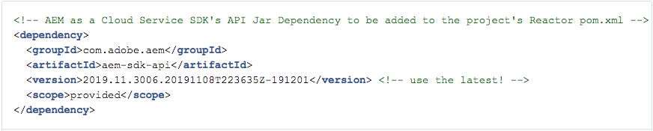
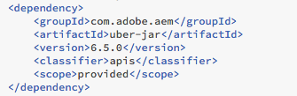
API Jar and pom.xml
pom.xml: Define a dependency on the API jar that matches the AEM version
pom.xml: Define a dependency on the API jar that matches the AEM version

Slide 130
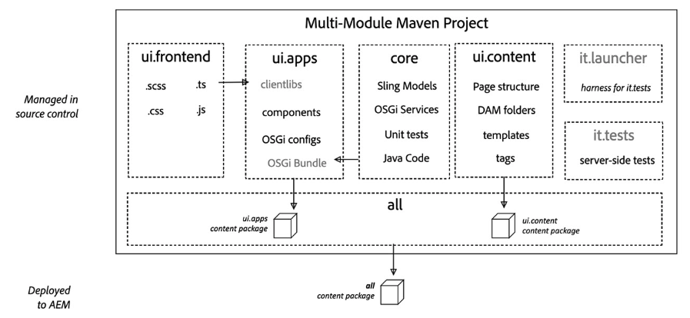
AEM Project Archetype 25
Strongly recommended for any Experience Manager project
Creates a minimal, best-practices-based Adobe Experience Manager project
Built in support for Adobe Experience Manager as a Cloud Service
Built in SPA support

Slide 131
AEM Project Archetype Modules
all – container package
core – java bundle containing core functionality
dispatcher – dispatcher configuration
ui.apps –/apps and /etc
ui.apps.structure – repository roots into which project code deploys
ui.config – OSGi configuration definitions
ui.content – content using the components from ui.apps
ui.tests – java bundle containing Junit tests that are executed server-side
ui.launcher - glue code that deploys ui.tests
ui.frontend.general – optional artifacts required to use the general Webpack-based front-end build module. Results of build copied into ui.apps as a client library
ui.frontend.react - optional artifacts required when creating a SPA project based on React. Results of build copied into ui.apps as a client library
ui.frontend.angular – optional artifacts required when creating a SPA project based on Angular. Results of build copied into ui.apps as a client library

Slide 132

AEM Maven Project
deploy modules as a single artifact
application java code
integration tests bundles
dispatcher configuration
OSGi configurations: /apps/osgiconfig
application code: /apps
empty package defines the repository roots that code packages in this project deploy
application content: /content, /conf
client library files and resources
Generated from Maven AEM Project Archetype 25
Notes:
‘all’ module contains only content packages and deploys a single artifact as a content package.
all module is what you send into the pipeline – single artifact
Good idea to demo and expand the modules so they can see what is there.
Orange = all module
Green = immutable
Blue = mutable
Red = tests
Purple = dispatcher

Slide 133
Application Deployments
Single package
Package should contain sub-packages for code, configuration and any supporting baseline content
Separation of content and code
Single content package cannot deploy to both mutable and immutable content
Application must separate code and content into discrete packages for deployment into AEM
Notes:
This will work with no changes for AEM 6.5 on prem. Good practice to prepare for move to the Cloud.
Single package should in turn contain sub-packages that comprise everything required by the application to function, including code, configuration and any supporting baseline content

Slide 134
Package Types
Container packages must have PackageType set to container
Example: all package
Code (immutable) packages must set their packageType to application
Example: ui.apps package
Content (mutable) packages must set their packageType to content
Example: ui.content package

Slide 135

Recommended Package Structure
Notes:
Based on AEM Archetype 21 or later. Archetype 23 has built in support for AEM Cloud Service.

Slide 136


AEM Cloud Service SDK
AEM cloud-ready quickstart jar
Download from Experience Cloud distribution site
What’s in it?
Cloud-ready Quickstart jar
Dispatcher tools
Dispatcher tools
Dispatcher tools
Dispatcher tools

Slide 137
Quirks of Local Development for AEMaaCS
Experience Manager cloud-ready Quickstart uses Replication, not Content Distribution
Classic replication capabilities needs to be used with an Author/Publish setup
Publication mechanism is backwards compatible with the Replication Java APIs
Could Service replication problems cannot be tested on a local cloud-ready instance
Dispatcher tools provide mechanisms to test dispatcher configuration
Local test of dispatcher make use of Docker, therefore you cannot test access to an Experience Manager instance through the dispatcher on a virtual image

Slide 138
Configuring the Cloud Service Dispatcher

Slide 139


Deploy Dispatcher Configuration with Code ***
AEM project
(from Archetype)
dispatcher
module
assembly
instructions for
dispatcher module
*** Adobe Managed Services and
Cloud Service only
Notes:
On prem customers will continue to deploy dispatcher as always.
Parent pom.xml file modified to load dispatcher module
Code with dispatcher module deployed through Cloud Manager

Slide 140

Adobe Experience Manager Cloud Service Dispatcher Configuration File Structure***
***Experience Manager 6.5
with Adobe Managed Services
expects different file names
Notes:
Same idea as AMS dispatcher configuration. Modified file names. Less freedom

Slide 141
Testing/Validating the Dispatcher Configuration Locally

Slide 142

AEM SDK Dispatcher Tools
The AEM SDK Dispatcher tools provide:
Vanilla file structure containing the configuration files to include in a maven project for dispatcher
Tooling for customers to validate a dispatcher configuration locally
Docker image that brings up the dispatcher locally
Docker image
run script
validator
scripts
Sample
dispatcher module
Notes:
Note: The Docker image cannot be run from inside the ReadyTech image. You cannot run a virtual image inside a virtual image. More later in the section on how to teach the dispatcher section.
Note: AEM Cloud Service maven archetype will generate the same dispatcher configuration file structure.

Slide 143

Set up Experience Manager publish instance
Remember AEM cloud-ready quickstart jar does not come with sample content
Start AEM Cloud Service local publish instance
Deploy application to publish instance
Profiles: –Padobe-public –PautoInstallPackagePublish
Test deployment by accessing application on publish instance

Slide 144

Dispatcher tools - validator Utility – create local dispatcher config files
output (dump) folder
Notes:
Clear up any issues caught by the validator. The necessary config files will not be written to the <output-foldername> until all issues are cleared up.
Note: I used an output/dump directory inside the dispatcher SDK folder for convenience in referencing the directory name from the scripts. You can put the config files anywhere you wish.

Slide 145

Run Dispatcher Configuration Test – start docker image w/ Apache
Execute docker_run.sh to start the docker image with the apache web server and the dispatcher in it.
./docker_run.sh out 192.168.0.14:4503 8080
folder with dispatcher config files
AEM publish instance IP address and port
Apache port
Notes:
Note: you must use your IP address. They seem to be working on why some machines need IP and some can use localhost.

Slide 146

Test Dispatcher Configuration
Test access through the apache web server (in the docker image) by using http://localhost:8080/content/wknd/us/en.html
Success!!

Slide 147
Additional Dev Resources

Slide 148
Core Components
Provides robust and extensible base components for Experience Manager, built on the latest technology and best practices
Open Source
Headless/SPA ready
Extensible
Pre-Configurable
Versatile and easy to use
Production ready
WCAG 2.0 accessible
Easy to style
SEO friendly
Versioned

Slide 149
Available Components
Breadcrumb
Form Button
Carousel
Form Container
Content Fragment
Form Hidden
Form Options
Form Text
Image
Language Navigation
List
Navigation
Page
Quick Search
Separator
Social Media Sharing
Tabs
Text
Title
All Core components are headless compliant!
More components come available all the time!

Slide 150

Open Source
Well Documented
Continuous improvements
Optionally upgrade
Notes:
https://github.com/adobe/aem-core-wcm-components

Slide 151

AEM Component Library
Online showcase of the current version
Interact with component variations
View the HTML and JSON output
Ships with Experience Manager 6.5 sample content
http://opensource.adobe.com/aem-core-wcm-components/library.html

Slide 152
ACS Commons
ACS Commons is:
A set of tools created and managed by ACS
An open source on GitHub
A method to bootstrap AEM projects with common functionality
A set of reusable components
An AEM development toolkit
ACS Commons is not a:
Framework library with required 3rd party dependencies
Library that changes standard AEM functionality
Notes:
ACS Commons is not a:
Framework library with required 3rd party dependencies
Library that changes standard AEM functionality

Slide 153

Administration Tools in ACS Commons
Common workflow processes
On-Deploy scripts
Manage Controlled Process
Manage Controlled Process (MCP) tools
Vanity path rewrite mapper
Health checks
Exporters
Workflow remover
JSON event logger
Audit log search
Dispatcher flush UI
Bulk workflow manager v2
Along with commons, developer tools and code samples are available in ACS.
Packagers (including permissions)
Dispatcher flush rules

Slide 154
Deployment using Cloud Manager

Slide 155
AMS: Deployment Architecture
Customer Code Changes
Adobe Release Orchestration
Customer Code CI/CD
Code Building/Testing
Non-Production Environments
Baseline AEM Releases
Image Building
Stage Deployment
Adobe Release Validation
Security Testing
Stage Environment
Adobe Code CI/CD
Regression Testing
Adobe Code Changes
Performance Testing
Production Environment
Prod Deployment
Notes:
Note: on prem deployments will follow the customer’s defined processes

Slide 156
AEM Cloud Service: Deployment Architecture
Customer Code Changes
Adobe Release Orchestration
Customer Code CI/CD
Code Building/Testing
Non-Production Environments
Baseline AEM Releases
Image Building
Stage Deployment
Adobe Release Validation
Security Testing
Stage Environment
Adobe Code CI/CD
Regression Testing
Adobe Code Changes
Performance Testing
Several Times a Day
Production Environment
Prod Deployment

Slide 157
Cloud Manager
Enables organizations to self-manage Experience Manager in the cloud
Includes continuous integration (CI) and continuous delivery (CD) framework
Allows IT teams and implementation partners expedite the delivery of customizations or updates without compromising performance or security

Slide 158
Programs
Are a set of environments
Support a customer brand, site, or initiative
Have one production environment
Can have many nonproduction environments
Usually correspond to a purchased Service Level Agreements (SLA)

Slide 159
Programs (Cont.)
A program maintains:
List of environments
CI/CD pipelines
Key Performance Indicators (KPIs) for testing
The provisioning and autoscale settings

Slide 160

Environment
A set of virtual computers within a Program
An AEM environment is composed of:
An author service
A publish service
A preview service
Three Environments in a Program

Slide 161

An Environment and its services

Slide 162
CI/CD Pipelines
Help speed up the delivery of custom code or updates
Have automated CI/CD pipeline that leverages Adobe coding best practices
Perform thorough code scan to ensure high code quality
Automate unit and performance testing
Produce the code performance report

Slide 163
CI/CD Pipeline Flow

Slide 164
Pipeline Configuration
Consists of:
The code branch from GIT repository
The triggers to start pipeline
The parameters to control production deployment
Performance test parameters

Slide 165
Pipeline Triggers
You can start the pipeline:
On GIT Changes - Starts the CI/CD pipeline whenever commits added to git branch
Manually - On-demand from the UI (or API)
Scheduled - This option will be coming soon in an upcoming release

Slide 166
Pipeline Gates
Three gates in the pipeline:
Code Quality
Performance Testing (production pipelines only)
Security Testing (production pipelines only)

Slide 167
Code Quality Testing
Scans the source code
Has more than 100 Experience Manager-specific and Java code quality rules
Is implemented with SonarQube

Slide 168
Code Quality Test Categories
Security rating
Reliability rating
Maintainability rating
Unit test coverage
Skipped unit tests
Other Issues such as vulnerabilities, bugs, and code smells
Duplicated lines

Slide 169
Security Testing
Cloud Manager runs Experience Manager security health checks on the stage following deployment and reports status through the UI.
Aggregates the results from all the Experience Manager instances in the environment.
If any instance fails a health check, entire environment fails that health check.

Slide 170
Performance Testing
Implemented using a 30-minute test
Traffic levels configured as part of pipeline setup
KPI thresholds configured as part of pipeline setup

Slide 171
Pipeline Process in Detail
Notes:
The following table details what is going on during each step of the process:
Pipeline Process Step / What is going on?
1. Start a release
A deployment manager triggers a release either manually, with a Git commit or based on a recurring schedule.
2. Create Release tag
Cloud Manager creates a Git tag to mark the release using an automatically generated version number. For example: 2018.531.245527.0000001222
3. Built as Release with auto-generated version
Cloud Manager builds the application with the newly-assigned version number.
4. Evaluate Code Quality
Cloud Manager scans the source code and provides a summary before code can be deployed to the stage environment
5. Versioned Artifact(s) Stored
The release artifacts is stored for later usage in the deployment steps.
6. Automatic Deployment of Artifact(s) to AMS AEM Stage
The release artifact is deployed to the stage environment.
7. Trigger Automated Tests
Cloud Manager runs the Performance and Security tests on the artifact.
8. Production Trigger Deployment
After automated tests are complete Cloud Manager starts the deployment to production.
9. Cloud Manager gets Artifacts(s) to Deploy
Cloud Manager pulls the stored release artifacts.
10. Deploy Artifacts(s) to Production
The release artifacts are deployed to the Production environment.
(from https://docs.adobe.com/content/help/en/experience-manager-cloud-manager/using/overview/ci-cd-pipeline.html)

Slide 172
Migration Tools to assist in moving to Adobe Experience Manager as a Cloud Service

Slide 173
Unified Experience
aio-cli-plugin-aem-cloud-service-migration plugin consists of two main parts:
User Interface
aio-cli commands to execute one or more code refactoring tools (via chaining the tools to be executed sequentially)
config.yaml which takes in the required input parameters
Code Refactoring Tool Suite
Scanning the respective section of customer’s code and manipulating the code (based on code implementation for best practices) to produce the output which can then be validated and deployed.
Producing a summary report to record the operations performed during execution

Slide 174
Repository Modernizer
Experience Manager requires a separation of content and code into discrete sub-packages to respect the split between mutable and immutable content
Utility
restructure existing project packages by separating content and code into discrete packages to be compatible with the project structure defined for Adobe Experience Manager as a Cloud Service
creates a compatible AEM Cloud Service project structure by creating the following deployment structure:
ui.apps package deploys to /apps and contains all the code
ui.content package deployes to runtime-writable areas (e.g. /content, /conf, /home, or anything not /apps) and contains all the content and configuration.
all package is a container package that contains the sub-packages ui.apps and ui.content

Slide 175
Asset Workflow Migration Tool
Migrate existing asset processing workflows from on-prem or Adobe Managed Services deployments of Experience Manager to:
Asset processing profiles
OSGi Configurations

Slide 176
AEM Dispatcher Converter
Convert existing on prem and Adobe Managed Services (AMS) AEM Dispatcher configurations to Experience Manager as a Cloud Service Dispatcher configurations

Slide 177
Index Converter
Migrate existing Custom Oak Index Definitions to Adobe Experience Manager as a Cloud Service compatible Custom Oak Index Definitions
Two ways to create Custom Oak Index Definitions:
under /apps (through any custom content package)
directly under /oak:index path
NOTE: Index Converter only transforms lucene type Custom Oak Index Definitions which are
present under /apps or /oak:index. It does not transform lucene type indexes which are created for nt:base.

Slide 178
Code Migration (from Static Templates to Editable Templates)

Slide 179
AEM Modernization Tools
Easy conversion of:
Static templates to editable templates
Design configurations to policies
Foundation Components to Core Components
Classic UI to Touch-Enabled UI
(More later on these tools…)
Note: The Modernization Tools are not accessible through the aio-cli interface.
They are uploaded to AEM from a content package

Slide 180
AEM Modernization Tools - Toolkit to Upgrade Existing Sites
Suite of tools for converting legacy Experience Manager features to the current capabilities.
Consists of:
Template Conversion Tool (Static -> Editable)
Policy Conversion Tool (Design Configurations -> Policies)
Component Conversion Tool (Legacy -> Modern/Core)
Dialog Conversion Tool (Classic -> Touch Enabled UI)

Slide 181
Conversion Scenario
The Geometrixx Shapes team has decided to upgrade their Static Templates to the new Editable Templates. They want to start with converting the Home Page template over to a new structure.
They've already set up an initial code using the Adobe Maven AEM Archetype. The next steps are to:
Create a template for the Home Page derived from a base template.
Configure the Home Page template for containers, policies, and components.
Covert the existing home page to use the new editable template.
Verify the updated page.
Notes:
https://github.com/adobe/aem-modernize-tools

Slide 182

Step 1 – Static Template Evaluation – Annotated Template Structure
Components should be identified by the new component types, not the existing components
Identify Structure components
Identify Structure components
Identify Structure components
Notes:
Note: There may be additional, nested structure components within the layout container.

Slide 183

Step 2 – Define the Structure of the Replacement Editable Template
Carousel
Header and Footer
Header and Footer
Two Columns
Two Columns
Nested Structure Components
Nested Structure Components

Slide 184
Step 3 – Convert a Page
Page Template/Structure Conversion Tool
Convert from a legacy static template to an editable template in three steps:
Convert Page Structure
Convert all parsys components to responsive grids
Convert all column controls to a new responsive grid structure, each column is its own responsive grid.
Notes:
The Page & Column control rewrite rules are configurable. For this lab, we have provided the default ones necessary to convert Geometrixx column control.

Slide 185

Page Conversion Configuration
Original Static template
sling:resourceType for new page-rendering component
New Editable template
Capture responsive grid names from the editable template. These will become the parsys replacements
Capture responsive grid names from the Editable template. These will become the parsys replacements.
Component order in the root layout container/responsive grid

Slide 186

Page Template/Structure Conversion Tool
Convert
Page(s) to be converted
Static template

Slide 187

Page Conversion Result
Components are in configured order in the root container
cq:template property points to Editable template
sling:resourceType for new page-rendering component
parsys replaced by responsive grids

Slide 188


Page Before and After Conversion
After
Before
Notes:
Just some small styling changes that will be addressed when the components are converted.

Slide 189
Scenario
The Geometrixx Shapes team realized they have a good amount of custom components on their projects, which they need to review every time Experience Manager gets updated.
An evaluation of their components and the Core Components revealed that they could use the latter as replacement for custom code in many situations and guarantee reduced upgrade work in the future.

Slide 190

Review Custom Components
geometrixx/components/header →
geodemo/comonents/content/header
geometrixx/components/lead →
geodemo/comonents/content/lead
geometrixx/components/title →
geodemo/comonents/content/title
foundation/components/image →
geodemo/comonents/content/image
geometrixx/components/text →
geodemo/comonents/content/text
Notes:
Notice you are reviewing the components used on the page, not the MUCH larger list of all available components. You convert the components on a page or the page and all of its children.
It is important to note here, that you will be modifying sling:resourceType property on the component node on the page to point to a new component that is either a proxy for a Core component or a newly defined custom component. You will not modify/convert the original custom component in /apps.

Slide 191

Component Rewrite Rules
Component rewrite rules found at /apps/cq/modernize/rules/<app>
Each rule has two parts:
Pattern
Replacement
Pattern to replace
Replacement
Notes:
Rule
Rule consists of 2 parts – Pattern and Replacement
Pattern
Each node under patterns is essentially a structure that must match for this rule to be applied. A rule may have multiple patterns, if any of the patterns match, then the rule will be applied.
In order to match, each of the properties, child nodes, and properties must match. In this case, the following must be true:
Node is of primary type nt:unstructured
Node has the property sling:resourceType set to foundation/components/image
Replacement
No matter how many patterns exist, there is only one replacement. This is used as the basis for writing the replacement node.
Process
Set the node's primary type to the static value nt:unstructured.
Set the sling:resourceType property to the static value geodemo/components/content/image.
Set the fileReference property to the original node's fileReference property.
Set the width property to the original node's width property.
Copy any children nodes from the original to the updated node. i. In the case of this Image component, there may be a binary file stored on the component. This last configuration will copy any files to the updated node.

Slide 192
Scenario
While upgrading their Static Templates to the new AEM Editable Templates, the Geometrixx Shapes team knew that it would be necessary to replace design elements with policy configurations. That work can be automated:
Evaluate the former design
Import design configurations as policies
Apply policies on editable templates
Notes:
cq:designPath would normally be removed from the website root during the page conversion process.

Slide 193

Geometrixx Design - /etc/designs/geometrixx
Design for each page type
Design for each page type
Assets that support the design
Stylesheet that supports Foundation components
Site-wide client library
Notes:
Drilling into the design for each page type will show the individual design elements for the page types and the components on pages of those types.

Slide 194

Migrating the Component Policies
Older Designs are referenced by the page/container/component path
Not reusable across page and container types
Page/container/component → contentpage/par/text
Design elements for this component on this page type

Slide 195


Design Conversion Rules
Notes:
The component rewrite rules are written in the same way as the component rewrite rules.

Slide 196

New Policies After Conversion
Newer Policies are referenced by sling:resourceType property
Independent policies that can be used in any layout container on any page type
Policy configurations for geodemo application
Policy configurations for geodemo application
Record of the conversion
Record of the conversion
Resource type associated with the policy
Default size

Slide 197
AEM Project Group Exercise
We will be looking at 3 case studies. For each case study you should design the path to Adobe Experience Manager Cloud Service
You have 45 minutes to work on your case study, then we will discuss each case study solution as a group.

Slide 198
Key Takeaways
General Cloud Service Deployment Process
Code is managed in a customer git repo
Normal development occurs
Branches can then be pushed into the Cloud Manager git for Cloud
Code is tested in non-production before moving to production
Use the Cloud Service SDK
Local Development environment is not exactly the same
New Dispatcher project module

Slide 199
Key Takeaways
Cloud Manager is single, essential entry point
Cloud Manager Pipeline Gates
Code Quality
Performance Testing
Security Testing

Slide 200
resources
Cloud Manager
https://docs.adobe.com/content/help/en/experience-manager-learn/foundation/cloud-manager/understand-cloud-manager-for-aem.html
Implementing Applications for AEM Cloud Service
https://docs.adobe.com/content/help/en/experience-manager-cloud-service/implementing/home.html
Cloud Service SDK
https://docs.adobe.com/content/help/en/experience-manager-cloud-service/implementing/developing/aem-as-a-cloud-service-sdk.html
Structure of an AEM project
https://docs.adobe.com/content/help/en/experience-manager-cloud-service/implementing/developing/aem-project-content-package-structure.html
Notes:
Note to CDs
For watching the Connect recording on ‘Tips for creating a great presentation’, you may need to download the Flash player, if it’s not downloaded already.

Slide 201
Security

Slide 202
Common web application attack techniques
Cross-site scripting (XSS)
Causing a website to execute malicious script code that has been previously uploaded by an attacker
SQL injection (SQLi)
A user enters malicious SQL statements into a field on a web page
Path traversal
Access unauthorized files or directories outside the web root folder by injecting patterns, such as “../”
Local file inclusion (LFI)
Use path traversal to or similar mechanism to cause the web application to execute a fiile residing elsewhere on the server
Distributed denial of service
Bombard a targeted web server with requests

Slide 203
Basic website security concepts
The following basic rules should always be applied to secure a website:
Make available as little information about your system as required
Emphasize access restriction and correct access implementation
Filter out invalid requests as early as possible, e.g, on firewall, web server or, dispatcher
Do not trust any information coming from the user or from an author to be safe
This includes making sure to protect against XSS and CSRF attacks

Slide 204
Every security issue matters
Even minor flaws should be fixed because:
attacking a website often needs more than one loophole.
even a combination of small loopholes can lead to severe security issues.

Slide 205
Protection against attack
Vulnerability scanning and security testing
Scanning and testing content repositories, networks and applications throughout the development lifecycle can identify where the vulnerabilities are, how dangerous they are and how to mitigate them
Web application firewalls (WAFs)
An important line of defense for critical applications and data, the WAF controls access to web applications using rules
Training
Proper training provides your developers, testers, project managers and architects with information about the latest components of secure software development

Slide 206

User Administration and Security
Authentication
Process of identifying and verifying a user
Proving who you are
Access Control
Restriction of access to a resource
Typically stored in list(s) of permissions granted or denied
Example: A page is read-only to users in a specific user group
Authorization
Determining whether a user is allowed to take action on specific areas within the system
Comparing an identity against a list of permissions
Example: Users in the authors group cannot create new templates
206

Slide 207
Actions and Permissions Best Practices
JCR Actions define the right that can be assigned to a group
JCR Permissions allow or deny a user to perform an action on a resource
For each action and on each resource in the repository, a user can have either permission state Allow or Deny.
Experience Manager permissions are granted through the various permissioning consoles:
Configuration Browser
Page Properties permissions tab
Asset Folder Properties permissions tab
AEM Permissions console (Tools > Security > Permissions)
Notes:
CRUD is Create, Read, Update and Delete

Slide 208
Actions and Permissions Best Practices (cont)
Experience Manager includes out-of-the-box users
Before going into production:
Delete all sample/unused users (e.g., application sample/test users)
Change the password for ALL out-of-the-box users
Notes:
CRUD is Create, Read, Update and Delete

Slide 209
ACL (Access Control Lists) Best Practices
Use groups to assign permissions rather than users
You have many more users than groups, so groups simplify the structure.
Groups help provide an overview over all accounts.
Inheritance is simpler with groups.
Users come and go. Groups are long-term.
Always use Allow statements to specify the access rights of the group principal (wherever possible). Avoid using a Deny statement.
Keep it simple

Slide 210
ACL (Access Control Lists) Best Practices
We have seen that ACLs are based on content hierarchy and child nodes inherit permissions.
As a consequence, security and access requirements should be a main driver when designing the content structure:
Managing access should be easy
Enforcing access control should come for free
Avoid copying content to containers such as /var/* for temporary operations or backup purposes.
Verify a proper permission setup.

Slide 211
Example Group Hierarchies
Everyone
Contributors
Contributors
Content Authors
groupX
Application
Admin
Content Authors
groupX
Notes:
Test steps:
Exercise permissions:
- create group2-> by default belongs to group ‘everyone’
- create test3 and assign it to group3
log in incognito with test 3, to crx/de or open a page
Review permissions for group2 -> no permissions over we-retail -> no access to http://localhost:4502/editor.html/content/we-retail/us/en.html
add group2 to contributors, -> partial in crx/de, but access to http://localhost:4502/content/we-retail/us/en.html
In incognito:
Go to sites and try to create a page under: http://localhost:4502/sites.html/content/we-retail/us/es. -> not possible
Review permissions for group2 -> read permissions for we-retail but nothing else
add group2 to content-author -> now you can create the page
Review also ACLs at path level -> allows more granularity with permissions
Create user test4, add it to contributors
Create an acl with all the permissions under -> /content/we-retail/fr
From sites you are now able to create pages under /content/we-retail/fr
Go to user admin and review permissions for test4 -> it has all the permissions for /content/we-retail/fr
More info:
https://helpx.adobe.com/uk/experience-manager/6-4/sites/administering/using/security.html

Slide 212
Security - Dispatcher
Notes:
Note: For AEM Cloud Service (and 6.5 AMS) the dispatcher configuration is deployed via a dispatcher module in the AEM Project.
httpd.conf and dispatcher.any files have been divided into multiple files, but functionality is the same.

Slide 213
Security Considerations - Dispatcher Configuration
For websites that do not require end user login, disable all means of getting an authenticated session. The following two rules can be implemented:
/1010 { /type "deny" /glob "* *sling:authRequestLogin*"}
/1011 { /type "deny" /glob "* *j_security_check*"}
In addition, HTTP headers authorization and proxy-authorization should not be included in the /clientheaders section (clientheaders.any)
Notes:
Review: Dispatcher is Adobe Experience Manager's caching and/or load balancing tool.

Slide 214
Security Considerations - Dispatcher Filtering
Configure the dispatcher to reject invalid and incorrect requests wherever possible.
Requests that are served should be configured from a whitelist:
Only content from valid resource trees and with valid extensions is served.
Both a security measure and a performance optimization method as the load on the Experience Manager instances is reduced
Notes:
DISPATCHER WHITELIST
To implement the recommended whitelist approach, the first directive denies all resources:
/filter
{
# Deny everything first and then allow specific entries
/0001 { /type "deny" /glob "*" }
Based on that first directive, selected resources are allowed in more fine-grained directives. The following example allows all requests to /content and all GET requests to css files:
/0023 { /type "allow" /glob "* /content*" }
# Enable specific mime types in non-public content directories
/0041 { /type "allow" /glob "GET *.css *" } # enable css
**********************************
DISPATCHER BASICS
The dispatcher configuration is made in file dispatcher.any, which is part of the webserver /dispatcher installation.
Dispatcher Caching Basics:
If a resource is denied in the dispatcher.any’s /filter section, a 404 error is returned
If a resource is allowed in the dispatcher.any’s /filter section but denied in the /cache/rules section, the resource is served always from AEM.
Only resources with an extension are cached: /foo/example is never cached, while /foo/example.html can be cached
Resources whose URL contains a querystring (‘?’) are never cached /foo/example.html?a=b
If the URL has a suffix path, the resource is only cached if the suffix path has an extension: /foo/example.html/suffix/path.html
Only resources retrieved with HTTP methods GET and HEAD are cached.
Only resources with HTTP status 200 are cached
HTTP response from AEM must not contain HTTP header “Dispatcher: no cache”
**********************************

Slide 215
Code Security

Slide 216
Code Security
Using Service-based Authentication for ResourceResolver and Repository session solves problems like:
Prevent over-use and abuse of administrative ResourceResolvers and/or JCR Sessions
Allow services access to ResourceResolvers and/or JCR Sessions without requiring hard-coded or configured passwords
Allow services to use service users that have been specially configured for service level access (as is usually done on Unix systems)
Allow administrators to configure the assignment of service users to services
Notes:
SLING MAPPER SERVICE
Configure Apache Sling Service User Mapper Service
Syntax
‘serviceName [ ":" subServiceName ] “=” username’

Slide 217



Service User Mapping Example
217
Notes:
Method for attaching an OSGi component to an authorized user
Ensures that the repository is accessed within the scope of the OSGi component
To use Service User Mappings:
Define JCR System User must be created and permissioned
Define config node for org.apache.sling.serviceusermapping.impl.ServiceUserMapperImpl.amended where: user.mapping = <service-name>[:<subservice-name>]=<authorizable id of a JCR system user>)
In servlet code, correct service methods must be used:
ResourceResolver getServiceResourceResolver(Map<String, Object> authenticationInfo)
Session loginService(String subServiceName, String workspace

Slide 218
Service User
ResourceResolver “borrows” JCR access permissions
Permissions provided by an existing JCR user
User is of type ”rep:ServiceUser”
Service User
ResourceResolver
User
Mapping
Service
JCR

Slide 219
Adobe IO

Slide 220
Adobe I/O
Highlights:
API endpoint for Adobe Experience Platform
One stop shop for developers
Access to Adobe Sensei
Replaced the Marketing Cloud developer connection
Used to securely connect to Adobe’s products to Experience Manager

Slide 221

Typical Setup of an I/O Integration
Example:
Adobe Identity Management System (IMS) Service Account
Tools > Security > Adobe IMS Configurations
Create a new public certificate
Log in to Adobe I/O and select the integration
Add the public certificate from Experience Manager
Add the private key from Adobe I/O to the IMS config

Slide 222

Adobe I/O Supported Services
*
*
*
* through Adobe Launch

Slide 223
Authentication and Authentication Handlers

Slide 224
Lightweight Directory Access Protocol
LDAP
Used for accessing centralized directory services
Helps to reduce the effort required to manage user accounts access by multiple applications
LDAP is often used for SSO
User accounts can be synchronized between the LDAP server and repository
This allows accounts to be assigned to repository groups
The repository uses LDAP authentication to authenticate users with credentials being passed to the LDAP server for validation, required for repository access
Successfully validated credentials can be cached by the repository, which improves performance
LDAP server validation is no longer granted when an account is removed
Notes:
LDAP IN AEM 6
AEM 6 LDAP support requires a different type of configuration than previous versions
In order to have LDAP working with AEM, three OSGi configurations need to be created:
LDAP Identity Provider (IDP)
Used to define how users are retrieved from the LDAP server
Sync Handler
Defines how the Indentity Provider users and groups will be synchronized with the repository
External Login Module
Define which Identity Provider and Sync Handler to use, effectively binding the two modules.
AEM 6 can be configured to authenticate with LDAP over SSL
************************************
A Word on Group Affiliation
Users synchronized through LDAP can be part of different groups in AEM. These groups can be external LDAP groups that will be added to AEM as part of the synchronization process, but they can also be groups that are added separately and are not part of the original LDAP group affiliation scheme.
In most cases, these can be groups that are added by a local AEM administrator or by any other identity provider.
If a user is removed from a group on the LDAP server, the change will also be reflected on the AEM side upon synchronization. However, all the other group affiliations of the user that were not added by LDAP will remain in place.
AEM detects and handles the purging of users from external groups by making use of the rep:externalIdproperty. This property is added automatically to any user or group that is synchronized by the Synchronization Handler and it contains information on the originating identity provider.
For more information, see Apache Oak documentation on User and Group Synchronization.
********************************
KNOWN ISSUES
If you plan on using LDAP over SSL, make sure the certificates you are using are created without the Netscape comment option. If this option is enabled, authentication will fail with a SSL Handshake error.

Slide 225

Oak External Authentication
Three main modules
External Login Module
Sync Handler
Identity Provider (IDP)
225

Slide 226
Setting up SAML Authentication
Defer authentication to a centralized server
OSGi Runtime environment
HTTP
JCR
HTTP listener
SSO Auth Handler
Servlet Engine (Jetty)
Remembers your current session
Identity Provider (IDP)
226

Slide 227

Adobe Identity Management System (IMS)
Adobe IDs used for accessing the Author tier:
Adobe Admin Console for managing users and user groups within the product contexts
Administrators are responsible for creating, or importing, the end users accounts in the Admin Console
Notes:
One of the major evolutions of AEM Cloud Service is the generalized use of Adobe IDs for accessing the Author tier
Benefits of using the Adobe Identity Management System (IMS):
Single-sign-on across all Adobe cloud applications
User profile information is centralized in the Adobe IMS system

Slide 228
Roles Within Adobe IMS
System Admin:
Receives an invite to log in to the Admin console
Claims Domain to confirm the ownership
Sets up User Directories
Product Admin assigns Experience Cloud products to users/groups
Experience Manager Admin manages the local groups, permissions, and privileges
are synchronized with the Admin Console
Notes:
Understand Adobe IMS - https://helpx.adobe.com/enterprise/using/identity.html
IMS with Managed Services - https://helpx.adobe.com/experience-manager/6-4/sites/administering/using/ims-config-and-admin-console.html

Slide 229
IMS Authentication
Three types of identities or accounts to authenticate and authorize users:
Federated ID
Enterprise ID
Adobe ID
Enterprise and Federated ID models are an ideal choice for enterprises
Adobe ID is best suited for individuals
Notes:
The three identity types are:
• Federated ID: Created, owned, and managed by an organization and linked to the enterprise
directory through federation. The organization manages credentials and processes Single Sign-On
through a Security Assertion Markup Language 2 (SAML2) IDP.
• Enterprise ID: Created, owned, and managed by an organization. Adobe hosts the Enterprise ID
and performs authentication, but the organization maintains the Enterprise ID.
• Adobe ID: Created, owned, and managed by the end user. Adobe performs the authentication and
the end user manages the identity.

Slide 230
IMS Authenticaton (Cont.)
An authentication service for all Adobe products
Tightly integrated with all Adobe products
In addition, AEM customers can use IMS service accounts for:
Smart Tags
Adobe Launch
Adobe Stock
Adobe Experience Manager Cloud Service customers can:
Manage users in the Experience Cloud Admin Console
Log in to AEM with IMS credentials
Have Enterprise or Federated accounts
230
Notes:
Google reCAPTCHA, Launch (Adobe Experience Cloud), Adobe Typekit, Facebook
This follows the context-aware approach as many integrations are Asset- or Site-specific, or folder-specific.

Slide 231
IMS Architecture

Slide 232

User Sync Tool (UST) – Create/Manage users with Active Directory
Notes:
https://docs.adobe.com/content/help/en/experience-manager-cloud-service/security/ims-support.html

Slide 233
Connect IMS to Experience Manager for Authentication
Customer onboarding to the Admin console is a prerequisite
Must have an IMS organization provisioned by Adobe
Joint effort between AMS and customers
Support for local and IMS authentication

Slide 234
Key Takeaways
Basic rules to secure a website:
Make available as little information about your system as required
Emphasize access restriction and correct access implementation
Filter out invalid requests as early as possible, e.g, on firewall, web server or, dispatcher
Do not trust any information coming from the user or from an author to be safe
Use service-based authentication for servlets
Generalized use of Adobe IDs for accessing the AEM Cloud Service
Notes:
.

Slide 235
Resources
Whitepaper
https://www.adobe.com/content/dam/acom/en/security/pdfs/adobe-aem-managed-services-security.pdf
IMS support for AEM Cloud Service
https://docs.adobe.com/content/help/en/experience-manager-cloud-service/security/ims-support.html
Notes:
.

Slide 236
JCR Model, Queries and Indexes

Slide 237
Explaining the JCR Model
A JCR repository:
Is hierarchical
Is flexible
Uses a standard Java API
Abstracts where the information is really stored
Supports queries and full-text search
Notes:
The JCR model is represented as a tree of nodes and properties. Nodes are addressed as a path that is similar to the file system and are used to organize the content in hierarchical form; properties store the actual data, either as simple types (such as string, Boolean, etc.) or as binary streams for storing files of arbitrary size.
A JCR repository:
Is hierarchical – you can organize your content according to your requirements, with related information stored together and which is easy to navigate.
Is flexible – the content can be adapted and evolved to be either schema-less or completely restrictive.
Uses a standard Java API
Abstracts where the information is really stored.
Supports queries and full-text search
********************************************
REMEMBER DAVID’S MODEL
Data First. Structure Later. Maybe.
Drive the content hierarchy, don’t let it happen.
References considered harmful.
Files are Files are Files.
IDs are evil.
Data First. Structure Later. Maybe
The basic idea of this concept is that while planning your repository, you need not use a structured approach to storing your data. Get used to storing data as nodes and properties, especially nodes of type nt:unstructured. Also, structure is expensive and in many cases it is entirely unnecessary to explicitly declare structure to the underlying storage.
For example, if you have a site with a time stamp on it, then this data can be stored in the form of an nt:unstructured node as you don’t have to do anything with that data. Your app will automatically know to extract that information as there is no need to declare it explicitly. Applications would implicitly know the structure that you use.
Data constraints such as mandatory or type and value constraints should only be applied where required for data integrity reasons.
Drive the content hierarchy, don’t let it happen
The content hierarchy is a very valuable asset, which is why you need to have good human-readable names for nodes, and not arbitrary numbers. Don’t directly convert your existing relational model into a hierarchical one, plan it accordingly. The content hierarchy drives:
ACLs
URLs
caching
search and content organization
For example, if you were to model a blog, then you would keep the blog posts separate from the comments due to access controls applied. That way, you can ensure that anonymous uses can only create comments, and not have access to the rest of the workspace except on a read-only basis.
References considered harmful
Reference imply referential integrity. References are costly from:
the repository point of view because it must manage the references
the content point of view because it affects flexibility
For example, if you have a page (a) that has a reference to another page (b), and if this reference is at the repository level, then you cannot export or import this page individually, as the target reference would be missing. Hence, it is better to model them as either ‘weak references’, or simple use a path to refer to another object.
Files are Files are Files
If a content model has something that even remotely resembles a file or a folder, then use the nt:file, nt:folder, or nt:resource.
A lot of generic applications allow interaction with nt:folder and nt:files implicitly and know how to handle and display those event if they are enriched with additional meta-information.
If you need to store the filename and the mime-type, then use nt:file/nt:resource.
If you could have multiple files, then use an nt:folder.
If you need to add meta information for your resource, such as an "author" or "description" property, extend nt:resource not the nt:file. I rarely extend nt:file and frequently extend nt:resource.
IDs are evil
In relational databases, IDs are used to express relationships between various fields (or data). Such is not the case in content modeling. If your model is full of IDs, then it means that you are not leveraging the hierarchy properly. The mix:referenceable property available in the repository is sufficient for node identification.
************************************
CONTENT SERVICES
JCR provides the following services which makes AEM a robust environment.
Author based versioning
Full textual searching
Fine-grained access control
Content categorization
Content event monitoring
************************************

Slide 238
JCR Model: Nodes and Properties
The JCR Model is a tree of nodes and properties
Nodes are addressed as a path that, similar to file system paths
Used to organize the content in hierarchical form
Nodes provide the structure
Properties store the actual data
simple types (such as string, Boolean, etc.)
binary streams for storing files of arbitrary size

Slide 239
JCR Content Services
Query (XPath, SQL, JQL)
Export/import (XML)
Referential integrity
Authentication
Access control
Versioning
Observation
Locking and transactions (JTA)

Slide 240

Query execution in Apache Jackrabbit Oak
Notes:
Go over Explain Query tool

Slide 241
Slow Query Classifications
There are 3 main classifications of slow queries in Experience Manager , listed by severity:
Index-less queries
Queries that do not resolve to an index and traverse the JCR’s contents to collect results
Poorly restricted (or scoped) queries
Queries that resolve to an index, but must traverse all index entries to collect results
Large result set queries
Queries that return very large numbers of results
Notes:
From:
https://experienceleague.adobe.com/docs/experience-manager-65/developing/bestpractices/troubleshooting-slow-queries.html?lang=en#detecting-large-result-set-queries
Detecting Index-less Queries
During Development
Explain all queries and ensure their query plans do not contain the /* traverse explanation in them
Detecting Poorly Restricted Queries
During Development
Explain all queries and ensure they resolve to an index tuned to match the query’s property restrictions.
Ideal query plan coverage has indexRules for all property restrictions, and at a minimum for the tightest property restrictions in the query.
Queries that sort results, should resolve to a Lucene Property Index with index rules for the sorted by properties that set orderable=true.
Detecting Large Result Set Queries
During Development
Set low threshholds for oak.queryLimitInMemory (eg. 10000) and oak.queryLimitReads (eg. 5000) and optimize the expensive query when hitting an UnsupportedOperationException saying “The query read more than x nodes…"
This helps avoiding resource intensive queries (ie. not backed by any index or backed by less covering index). For example, a query that reads 1M nodes would lead to lots of IO, and negatively impact the overall application performance. So any query which fails due to above limits should be analyzed and optimized.

Slide 242
Query Performance Analysis and Optimization
Efficient:
Simple comparison: sling:resourceType = ‘my/type’
Node type match: //element(*, nt:hierarchyNode)
Simple fulltext search: jcr:contains(@jcr:title, ‘crx’)
Like on few distinct values: jcr:like(@jcr:mimeType, ‘%/plain’)
Notes:
Typically O(n) where n is the number of results, vs. the total number of nodes

Slide 243
Query Performance Analysis and Optimization (cont)
Less efficient:
Path constraints: content/geometrixx/en//*[ ... ]
Alternative: turn path into property constraint. E.g, keep language property on every page and write: //*[@language = ‘en’]
Relative path in predicate: //element(*, cq:Page)[jcr:contains(jcr:content, ‘crx’)]
Alternative: shorten path in predicate and post process result: //element(*, cq:PageContent)[jcr:contains(., ‘crx’)]

Slide 244
Query Performance Analysis and Optimization (cont)
Not efficient :
jcr:contains w/ initial wildcard: jcr:contains(., ‘*rabbit’)
Alternative: don’t do it, unless you know exactly what you are doing!
jcr:like on many distinct values:jcr:like(@email, ‘%@gmail.com’)
Alternative: store data you want to query in separate property, then you can write: @email-host = ‘gmail.com’
Ranges matching many distinct values: @jcr:lastModified > xs:dateTime(‘2001-09-17T18:17:13.000+02:00')
Alternative: reduce resolution (e.g, only store date and not time)
Notes:
type=cq:Page
property=jcr:content/cq:tags
property.value=we-retail:activity
http://localhost:4502/libs/cq/search/content/querydebug.html
Create index for property cq:tags

Slide 245
Query Performance Analysis and Optimization (cont)
Query result does lazy loading of nodes
Query.execute() may return quickly even if result size is big
Reading a large result set completely is always slow
Time to get result: query execution time + node retrieval time
Notes:
Recommendations
Test with real content
Structure content to avoid queries
Denormalize
Avoid path constraints
Replace frequent queries with initial query + event listener
https://helpx.adobe.com/uk/experience-manager/6-4/sites/developing/using/troubleshooting-slow-queries.html

Slide 246
Key Takeaways
Oak does not index content by default
Query engine uses a cost-based query and selects the index with the lowest cost
Only create indexes if there are a large number of unique values
Lucene indexes
Offer many more features than property indexes
Asynchronous
Cannot enforce uniqueness constraints
QueryBuilder is a service for building queries searching the JCR and which are easily extensible.

Slide 247
Key Takeaways
AEM Cloud Service Index Management
Create Index on deployment before application requires it
Index Management With Blue-Green Deployment
No downtime.
Requires that indexes only be used by certain versions of the application.

Slide 248
Resources
Content Search and Indexing
https://docs.adobe.com/content/help/en/experience-manager-cloud-service/operations/indexing.html

Slide 249
Performance

Slide 250
Poor Performance
The following factors negatively impact performance in Experience Manager:
Improper design
Application code with bad practices
Poor network bandwidth and latency

Slide 251
Optimization to Avoid Performance Issues
Find and fix performance issues before they have an impact on your users:
Oak Query Engine / Index optimizations
Cacheability
CRX Performance
Lucene Index performance
Notes:
How To:
Implement and execute load tests that simulate realistic scenarios in both author and publish instances
Stress testing – defines the maximum load the system can handle
Install the recommended AEM services packs and hot fixes
The Windows OS versions below have been identified as problemmatic:
OS name: Microsoft Windows Server 2008 R2 Enterprise(Version: 6.1.7601 Service Pack 1 Build 7601)
OS name: Microsoft Windows Server 2012 Standard(Version: 6.2.9200 Build 9200)
During times of high write activity (for example, during a large package install) could result in using most of the native memory if memory mapped I/O is enabled
5. AEM6.x either crashes or is slow during a large Asset uploads. Heap dump analysis shows that the CQBufferedImageCache is consuming 1/4 or more of the heap
The default maximum cache size for CQBufferedImageCache is set to 1/4 of the JVM heap size
**************************************
Oak Query Engine / Index Optimizations
Make sure that you have the latest Oak version installed for your AEM 6.x instance
Install recommended indexes
Create custom oak indexes for all frequently used search queries
Add JVM parameters in the AEM start script to prevent expansive queries from overloading the system
Lucene index configuration
Enable CopyOnRead
Enable CopyOnWrite
Enable Prefetch index files
DataStore – when dealing with large numbers of binaries, it is recommended that an external data store be used instead of the default node stores to maximize performance

Slide 252
Basic Process: The Application is SLOW!
Perceived Problem
Challenge and Understand
Reproduce and Measure
Analyze and Fix
Confirm Solution or Repeat
Notes:
Challenge and understand the problem
Reproduction and measurability
General troubleshooting tools
Understanding actions and causes
Understanding component performance
********************************************
Don’t buy into existing interpretations
First, ask what marketing / business / etc. expects the system to do? Ask what the difference to actual behavior is, what the symptoms are and what the business impact is? What pain is resulting from the problem not on a technical level, but for the people that use the system directly (e.g. authors) or indirectly (e.g. marketing people or website visitors)?
Understand expected behavior versus actual behavior
Make sure you understand what the piece you’re looking is is meant to do, what the business requirements for it are. That’s important because often the solution to a problem is to remove over-engineered solutions, so you must understand what functionally needs to be retained.
Understand the impact
Is what is expected and what the actual expected behavior of the product, or is there an issue in expectation management? If it’s the latter, the resolution might be not an immediate technical task, but require a re-design or re-setting of expectations together with an engagement or account manager.
Understand motivators and requirements
Often people will interpret symptoms that they see to be due to a particular problem but haven’t had more than a brief look.
It’s like having a problem with your car and assuming the motor has died without looking if you’re out of gas.
Understand if expectations are set rightly
Once these prerequisites have been cleared, you can start your quest for the actual cause of the problem, factoring out everything that is just a symptom.
The rest of this presentation will show you the tool you have available for doing that
*****************************************
REPRODUCTION AND MEASUREABILITY
Measure success
The most important tool in your quest for a solution is to first create a test setting that reproduces the issue and by which you can measure your success
For functional, resource and performance problems alike (harder to to but just as important for the latter two)
Measure assumptions
You’ll want this not only to measure success but also to have a benchmark for different configurations or implementations
Follow a cycle of measure – evaluate – change to obtain objective results that are comparable
Be real
Make sure your tests match the situation in which the problem occurs
Work with the same number of items that are involved (workflows, events, users, pages, replications)
Work with the same hardware setup for performance and resource problems
******************************************
GENERAL TROUBLESHOOTING TOOLS
Unless the system is totally down, thread dumps can usually be captured from the Configuration Status tab in the OSGi Web Console.
SOURCE CODE
If you found the hotspot or a suspicious candidate, look at the source code to validate your assumptions of what the product is expected to do
READ LOG FILES
Don’t guess, read the logfiles to see what is happening
Turn the loglevel to debug for suspect areas
COMMON LOG FILES
request.log
The request log logs the entry and exit of each request into and out of the system together with the entry time, exit time, time to process the request, a request counter as well as the final status code and response content type.
error.log
Log messages of various severity levels depending on the configuration
dispatcher.log
Log messages written by the dispatcher, including requests, served from cache or from renderer, requests denied etc.
3rd party log files
Depending on the environment you may need to inspect log files for other components like the web server, operating system, servlet container etc.
ATTACH A DEBUGGER
If you can, attach a debugger to see where expected deviates from the actual
Or attach a profiler if you are tackling a resource or performance problem
CAPTURE THREAD DUMPS
Thread dumps provide you with a list of threads and their states in the JVM
They are especially useful when troubleshooting system slowness
USE EXISTING EXPERTISE
Use support and documentation resources to see if you’re hitting a known problem and to understand if there’s a workaround or a Hotfix
https://issues.adobe.com
Http://dev.day.com
http://daycare.day.com/home.htmlUse DL-tech to ask if someone else has hit the problem
Be sure you have described your problem well and that it’s reproducibly
Be sure that you have separated symptoms and causes
***************************************
UNDERSTANDING ACTIONS and CAUSES
Requests
look at request.log and use rlog
use your browser’s developer console
use the “Recent Requests” and “HTTP Whiteboard” consoles to see request details and filters
Workflows
see which workflow launchers are set up
look at the workflow models and their implications
Sling Eventing / JCR Observation
look at EventHandler or EventListener implementations that have costly implementations, trigger often, or do heavy lifting synchronously
look at the Sling Event Queues
**********************************************
COMPONENT PERFORMANCE
Use the “Recent Requests” console to see requests in detail
Use the performance chart rendered in the HTML source
Watch out for expensive operations
Things that are typically not a big performance thing:
StringBuilder vs StringBuffer vs String + String
Things that can break your performance:
JCR Queries
Heavy tree traversals
Look for work that can be done asynchronously instead of in-request
This can be offloaded to AJAX requests so the page loads fast
(but make sure the AJAX request is still cacheable)

Slide 253
Experience Manager Architecture
Customer Application
What we call ‘Experience Manager ’ is really a complex multi-layered application
Each layer has separate responsibilities and characteristics
Generally things don’t go wrong without some triggering event
Failures in any layer often manifest as visible issues in the layers above
Excessive demand from above can cause issues in lower levels
We need to track back from symptoms to identify root-cause
Experience Manager
Apache Sling
Apache Oak
Jetty
Apache Felix
JVM
Operating System

Slide 254
Experience Manager Architecture - Symptoms and Causes
Customer Application
Customer Application
Symptom: Components failing to render / exceptions in the log
Cause: Bad / unexpected data
Cause: Bugs in customer application
Cause: Bundles and services not starting
Symptom: Slow page rendering times
Cause: Bottlenecks in lower tiers (Sling Models, Oak)
Cause: Slow external/backend calls
Cause: Excessive JVM GC
Experience Manager
Apache Sling
Apache Oak
Jetty
Apache Felix
JVM
Operating System

Slide 255
Experience Manager Architecture – Symptoms and Causes
Customer Application
Adobe Experience Manager
Web Content and Asset Management
Platform
Symptom: Unexpected behavior in Authoring UI
Cause: Overlays out-of-date (due to hotfix, service pack or feature pack)
Cause: Bad / unexpected data
Symptom: Workflows failing to appear in console
Cause: Async indexer failing
Symptom: Slow to start up
Cause: Long Sling job queues
Experience Manager
Apache Sling
Apache Oak
Jetty
Apache Felix
JVM
Operating System

Slide 256
Experience Manager Architecture – Symptoms and Causes
Customer Application
Apache Sling
RESTful API on repository
Routes requests to scripts (code)
Symptom: Updated artifacts not being picked up from repository
Cause: Sling OSGI / JCR installer failing
Experience Manager
Apache Sling
Apache Oak
Jetty
Apache Felix
JVM
Operating System

Slide 257
Experience Manager Architecture – Symptoms and Causes
Customer Application
Apache Oak
No-SQL persistence layer supporting multiple backends (Tar files, Mongo, RDBMS)
Implementation of Java Content Repository standard
Symptom: Async indexes failing
Cause: Missing binaries in Datastore
Cause: Index corrupt on disk
Symptom: Slow query processing
Cause: Missing index or incorrect index selection
Symptom: Rapid repository file growth
Cause: looping workflows
Experience Manager
Apache Sling
Apache Oak
Jetty
Apache Felix
JVM
Operating System

Slide 258
Experience Manager Architecture – Symptoms and Causes
Customer Application
Apache Jetty
Web Container (providing servlets / jsp support)
Receives incoming requests and routes passes to Sling for processing
Symptom: Server not accepting requests
Cause: Thread limit reached due to slow processing of previous requests
Experience Manager
Apache Sling
Apache Oak
Jetty
Apache Felix
JVM
Operating System

Slide 259
Experience Manager Architecture
Customer Application
Apache Felix
Implementation of OSGI (Module and service framework for Java)
Symptom: Artifacts not installing
Cause: Sling OSGI / JCR installer blocked or failing
Symptom: Unable to authenticate / admin password changed
Cause: Repository failing to start
Experience Manager
Apache Sling
Apache Oak
Jetty
Apache Felix
JVM
Operating System

Slide 260
Experience Manager Architecture – Symptoms and Causes
Customer Application
Java Virtual Machine
Symptom: Excessive garbage collection
Cause: Memory leak
Cause: Large or inefficient query result set
Experience Manager
Apache Sling
Apache Oak
Jetty
Apache Felix
JVM
Operating System

Slide 261
Experience Manager Architecture – Symptoms and Causes
Customer Application
Operating System (RHEL – Red Hat Enterprise Linux)
Symptom: Large IO Wait
Cause: TarMK memory mapping inefficient
Symptom: Too many open files
Cause: Repeated failed async index cycles
Symptom: Excessive memory consumption
Cause: JVM heap too large
Cause: Consumption by ’native’ components (ImageMagick, FFMPEG, XMP, CameraRAW, Flite etc)
Experience Manager
Apache Sling
Apache Oak
Jetty
Apache Felix
JVM
Operating System

Slide 262
Identifying the Problem Area
Unless you have seen the exact scenario before, the first step will be to identify the overall problem area
AEM provides a number of tools which can provide hints that things are not working as they ought to be
By checking each of these, you can identify any unexpected results which might require deeper investigation
Request Log
Access Log
Error Log
Custom Logs
Request Performance tool
Query Performance tool
JMX Beans
Profiler
Chrome Plugin
NewRelic
Operating System tools like Top
Notes:
Some really useful JMX beans
IndexStats (‘async’, ‘async-fulltext’) – identify if indexers are failing and shows last failing index error
Consolidated Listener Stats – shows if observation queue is hitting max length (default = 1000, often increased to 50,000) at which point events are collapsed and converted to external events – listeners might miss them.
Often poorly implemented customer listeners can contribute to this (listeners should do no heavy work)

Slide 263
Digging Deeper
After identifying the problem area, it’s time to dig deeper to try to understand the root cause.
Different set of tools and skills
Sometimes the issue is obvious on deeper inspection
Sometimes it’s necessary to formulate a theory
Use deeper investigation to prove or disprove it
Thread Dumps and Heap Dumps
pmap
Open source product Jira and Git
Application Source
Notes:
Pmap - View details of all the files memory mapped by the AEM process
Grep for ‘.tar’ to see how much of the TarMK segmentstore is resident in memory

Slide 264
Tooling
Available system monitoring data
Tools on OS level (perfmon, iostat, top, netstat, tcpdump, …)
Leverage threaddumps (either via kill–QUIT or via Felix Console)
Garbage collection logs of the JVM
request.log
End-to-End monitoring / end-to-end benchmarks
jVisualVM
Notes:
https://helpx.adobe.com/uk/experience-manager/6-4/sites/administering/using/operations-dashboard.html

Slide 265
Key Takeaways
What we call ‘Experience Manager ’ is really a complex multi-layered application
Each layer has separate responsibilities and characteristics
Generally things don’t go wrong without some triggering event
Failures in any layer often manifest as visible issues in the layers above
Excessive demand from above can cause issues in lower levels
We need to track back from symptoms to identify root-cause

Slide 266
Solution Design

Slide 267
Solution Design: Background
Designing solutions is a large part of the Architect role
Solution designs must be detailed enough for hand-off to the customer or partner for implementation
The Architect must ask the “glass ball” questions and not be short-sighted in the design
The customer has requirements, but may not understand the possible technical impacts of their choices
Document assumptions in the design:
Amount of data
Data change rates
Implementation requirements and performance risks
Infrastructure requirements
Business process (workflow) impacts
Notes:
Only hint that their solutions will be used later
Most of the time for this presentation will be to get the groups together, hand out assignments and start asking questions

Slide 268
Final Solution Design Exercise
Each group will get a different assignment
Produce some real-world solution designs
Each group will present their task, solution, and answer questions
Make the solutions detailed and implementation-ready
Instructor represents the customer

Slide 269
Notes:
Red background – ending slide

